Slide 1
Ethereum Blockchain
신민호
mhshin@mju.ac.kr

Slide 2
Session 1: Introduction

Slide 3

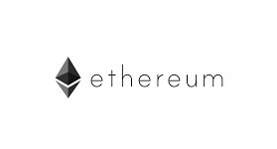

Why Blockchain?
COMPUTING PARADIGM

Slide 4
Why Blockchain is Difficult?
Cryptography
Public Cryptography
Secure Hashing
Security
Integrity
Authenticity
Non-repudiation
Proof-of-Work
P2P Networking
Programming languages
Solidity
Vyper
Go
Javascript
Complex operation mechanisms

Slide 5
Session 2: Building Blocks

Slide 6
Prerequisites
Peer-to-peer networking
Security principles
Public cryptography
Cryptographic hash
Consensus

Slide 7
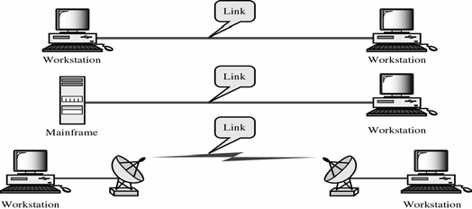
Peer-to-Peer Networking (P2P)
Communication Models
Point-to-Point
Client-Server
Peer-to-Peer
Scalability
No Single-point-of-failure
No governance

Slide 8
Operations of P2P Network
Network 구성
주변/랜덤 노드들과의 연결을 통한 그래프 형성
정보 전달
Flooding: 정보를 전체 네트워크에 Broadcast
Unicasting: 특정 노드로 메시지 전송 (Routing protocols)
네트워크 참여
Join/Leave protocol
Blockchain protocols
Bitcoin Network
Ethereum: ÐΞVp2p protocol

Slide 9
Security Principles & Blockchain
보안 3대요소: CIA
Confidentiality (기밀성)
보장하지 않음
Integrity (무결성)
[BC] Transaction, Block, Address
Availability (가용성)
Denial of Service (DoS) 공격
Authenticity (인증)
Signature로 Ownership 증명 (Anonymous)
Anonymity (익명성)
One time public key
Non-repudiation (부인방지)
Signature

Slide 10
Public Key Cryptography
비밀키
대칭키 암호
DES, 3DES, AES, ARIA
비밀키
비대칭키 암호
RSA, ECC

Slide 11
Why Public Key Cryptography?
발상의 전환 1: 키배분
누구나 나에게 암호문을 보낼수 있다
발상의 전환 2: 전자서명
누구나 내 암호문을 풀수 있다?
공개키쌍(Key pair)
Public Key(공개키): 누구나 알 수 있음. 암호에 사용. 서명 확인에 사용.
Private Key(개인키): 소유자만 알고 있음. 복호화에 사용. 서명에 사용

Slide 12
What is Public Key Infrastructure?
공개키암호의 한계: 주어진 공개키가 누구의 것인가가 불분명
인증서: 신뢰자가 공개키의 주인을 증명(Certify)하는 문서 (발급자서명)
발급자의 공개키는 누가 인증할것인가? 풀수없는 문제
Leaf인증서
CA인증서
RootCA인증서
상대방의 공개키를
어떻게 확실하게
확인할 수 있는가?
공개키
공개키주인
발급자
발급자서명
공개키
공개키주인
발급자
발급자서명
공개키
공개키주인
발급자:Self
Self서명
확인
확인
확인
PKI (Public Key Infra.)

Slide 13
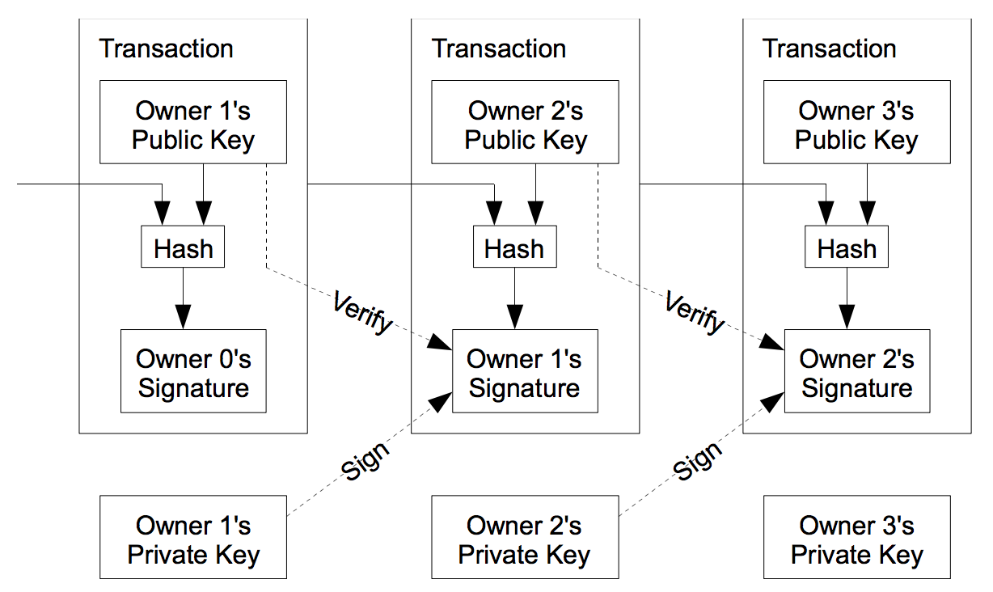
Public Key Crypto in Blockchain
서명알고리즘 사용
Asset에 대한 Ownership을 증명하는데 사용
A로부터 받은 돈을 B가 사용할 때 B가 서명으로 소유권 증명
B가 생성/설치한 Smart Contract에 대한 생성자 증명

Slide 14
Public Key Crypto in Blockchain
Proof-of-Authority (PoA)
Ethereum의 변형으로 일부 testnet에 사용(Kovan)
서명확인된 Miner만 블록생성 가능
서명 알고리즘
ECC (Elliptic Curve Cryptography) 기반 서명

Slide 15
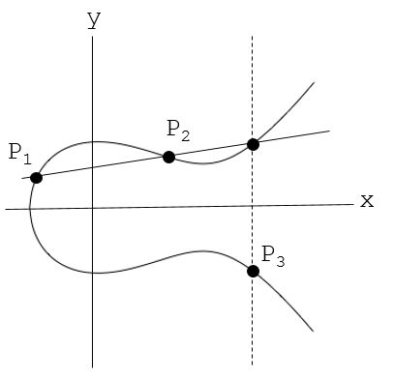
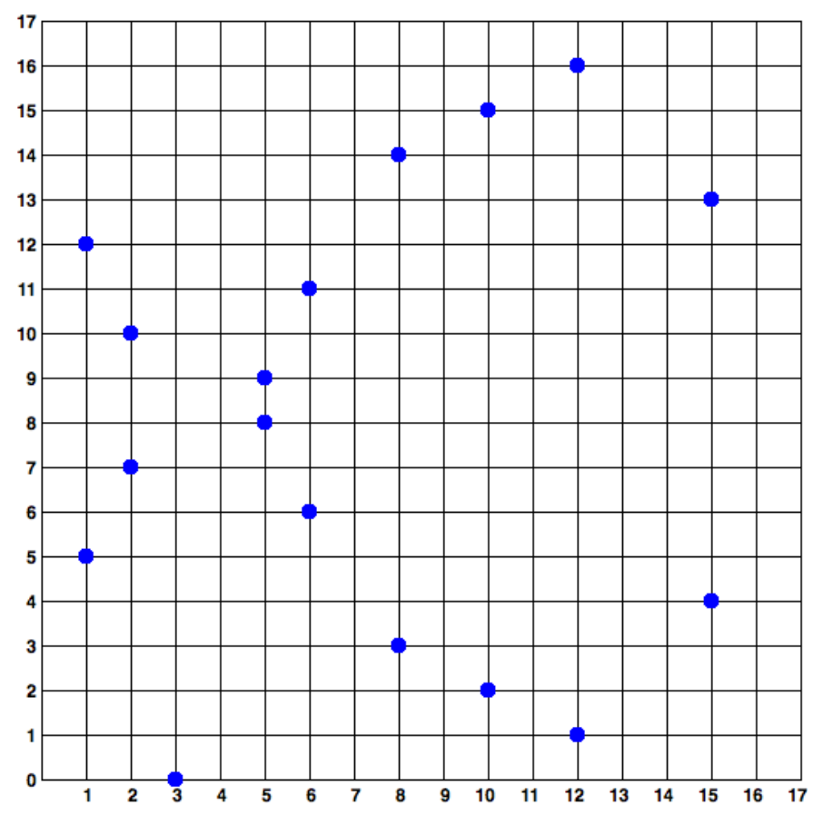
Elliptic Curve
Elliptic Curve
y² = x³ + ax + b
곡선우 두 점을 이으는 선을 그리면 반드시 한점에서만 곡선과 교차
Elliptic Curve Algebra
P1 + P2 = P3
0(항등원) = Infinity point
Elliptic Curve Cryptography
큰 솟수(p)의 필드(Fp) 기반
secp256k1
y² = (x³ + 7) over (F_{p})
p = 2²⁵⁶ - 2³² - 2⁹ - 2⁸ - 2⁷ - 2⁶ - 2⁴ - 1

Slide 16
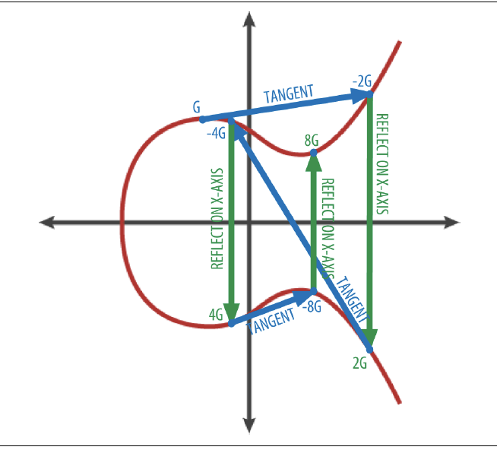
Elliptic Curve Cryptography
Given
Elliptic Curve (a, b, p)
Generator G
Pick a random number K
Compute K*G
Public key (x,y) = K*G
Private key = K
KG로부터 K를 구할 수 없음
RSA보다 10배 적은 키로 비슷한 보안성 유지

Slide 17
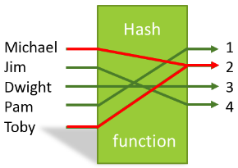
Hash & Cryptographic Hash
Hash
임의의 길이의 Input을 고정된 길이 output으로 변환
Input값들을 균등하게 변환시켜줌
Constant-time search를 위해서 사용
EX: mod p
Cryptographic Hash (Secure Hash)
One-way function
Eash to compute
Collision Resistance (weak or strong)
같은 Hash값을 갖는 input을 찾을 수 없다
Bitcoin uses SHA256
Ethereum sues Keccak256 (SHA3 원형)

Slide 18
Proof of Work puzzle
주어진 d에 대해서, 그 Hash값이 d개 이상의 0으로 시작하도록(<2^{256-d}) 하는 M을 찾는 문제
Secure hash에 대한 유일한 해답은 brute-force방법
d(difficulty)가 증가할 수록 기하급수적으로 오래걸림
M
success
fail
0
2^{256-d}-1 ={0}^{d}{1}^{256-d}
2²⁵⁶-1={1}²⁵⁶

Slide 19
Origin of Proof-of-Work: Hashcash
Originally proposed by Cynthia Dwork
Hashcash proposed by Adam Back
Sending an email costs a PoW
Find a <counter> s.t.
SHA-1(1:20:<time>:<recipient>:<rand>:<counter>)={0}²⁰{0,1}¹⁴⁰
Takes about 1 sec
Receiver accepts an email only if
<time> is recent(2-days), <recipient> is correct
and valid PoW
This prevents a spammer
whose business relies on the ability to send many emails quickly

Slide 20
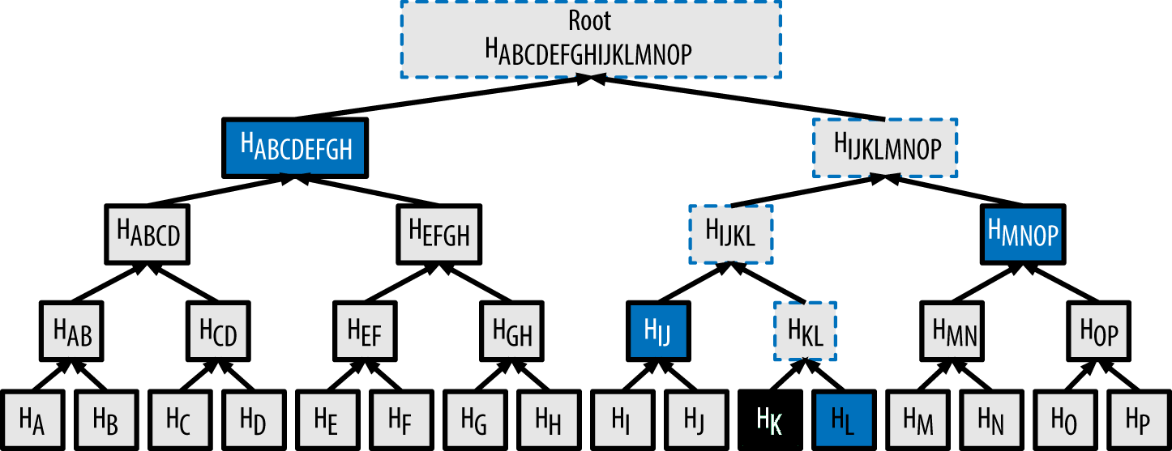
Merkle Tree
다수의 데이터(tx)의 hash를 계산하되, 특정 데이터(tx)의 포함 여부를 빠르게(log N) 검사할 수 있는 기술
Block Header에 transaction Merkle 해시값만 저장
HK의 포함확인을 위해서 모든 15개 다른 데이터가 필요
Hash
HK의 포함확인을 위해서 4개의 데이터만 필요

Slide 21
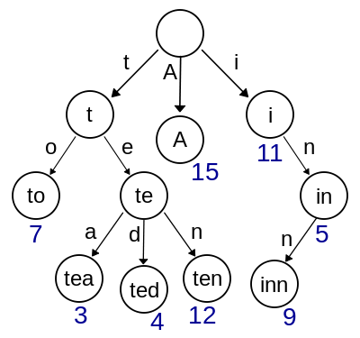
Modified Merkle Patricia Tree
Ethereum에서 state (key, value)를 저장하기 위해서 사용
Merkle tree와 Patricia trie를 합친 기술
Patricia Trie (Prefix Trie)
Key string의 value를 빠르게 찾는 기술
MPT
State key로 Patricia Trie를 구성
해당되는 Merkle tree Hash값을 구함
이가지고 DB에서 value를 구한다

Slide 22
Session 3: Cryptocurrency

Slide 23
Electronic Money Problem
Electronic money
모든 Cash Flow를 추적하여 모든사람의 자산을 파악 (Transaction)
모두가 신뢰할 수 있는 정보 (Consensus)
Easy solution
모든 Transaction을 Trusted Third Party (TTP) 를 통해서 실행
TTP에 대한 신뢰가 필요
Hard solution
distributed solution (누구의 도움도 없이 거래. 현재 Cash와 같음)
Why difficult?
Double spending (중복지불)을 감지할 수 없음
Bitcoin 은 consensus algorithm으로 해결

Slide 24
How Bitcoin works (without Why)
cash flow를 transaction chain에 기록
유효한 tx(no double spending)은 block에 저장
각 block은 chain으로 연결됨
모두(대다수)가 합의한 (가장 긴) block chain만 신뢰
Hash-point →
이전 tx/block의 hash값을 다음 tx/block에 기록
중간의 tx/block이 수정되면 연결이 끊어짐
P2P 네트워크로 tx/block 교환
각 tx은 지불자가 서명
각 tx은 수신자의 공개키(의 hash) 표기
Miner가 유효한 tx를 모아서 block 생성
가장 긴 blockchain에 추가(append)
PoW을 푼 block만 유효함
Longest block-chain 이 consensus 획득
Block 23
Block 24
Block 25
Block 26
A→B: $2
B→C: $1
D→L: $1
C→H: $1
C→D: $3
D→A: $2
S→J: $1
K→P: $1
E→F: $3
E→S: $1
F→K: $3
L→X: $1

Slide 25
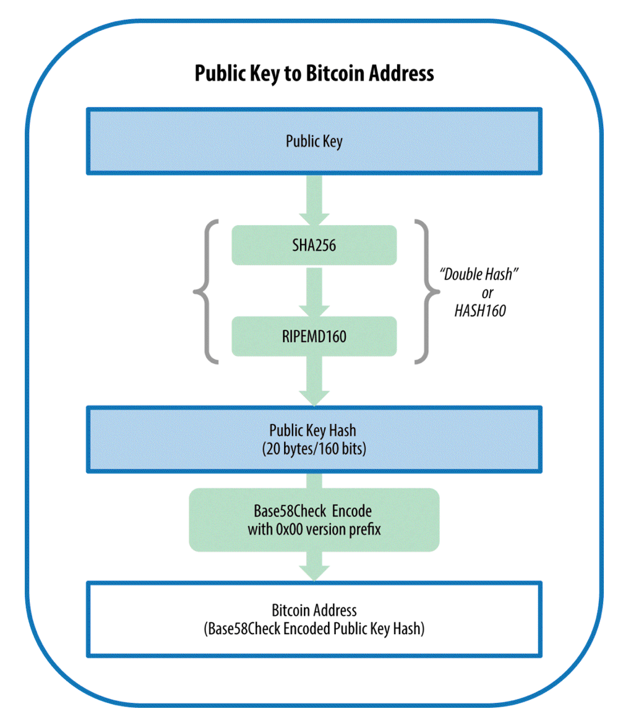
Bitcoin Address
BTC에 대한 소요권을 나타내는 주소
소유자의 Public Key의 해시값으로 주소 생성
소유자의 Signature와 Public Key가 주어지면 소유권을 검사가능

Slide 26
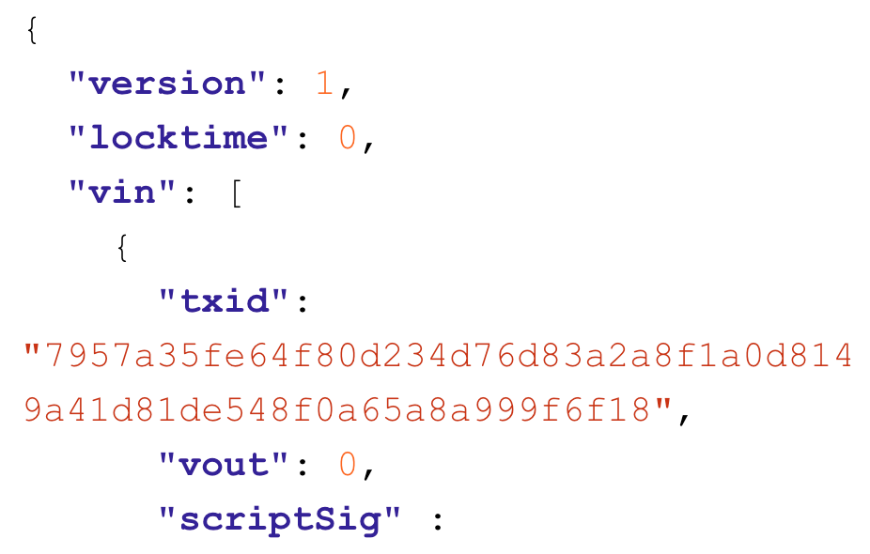
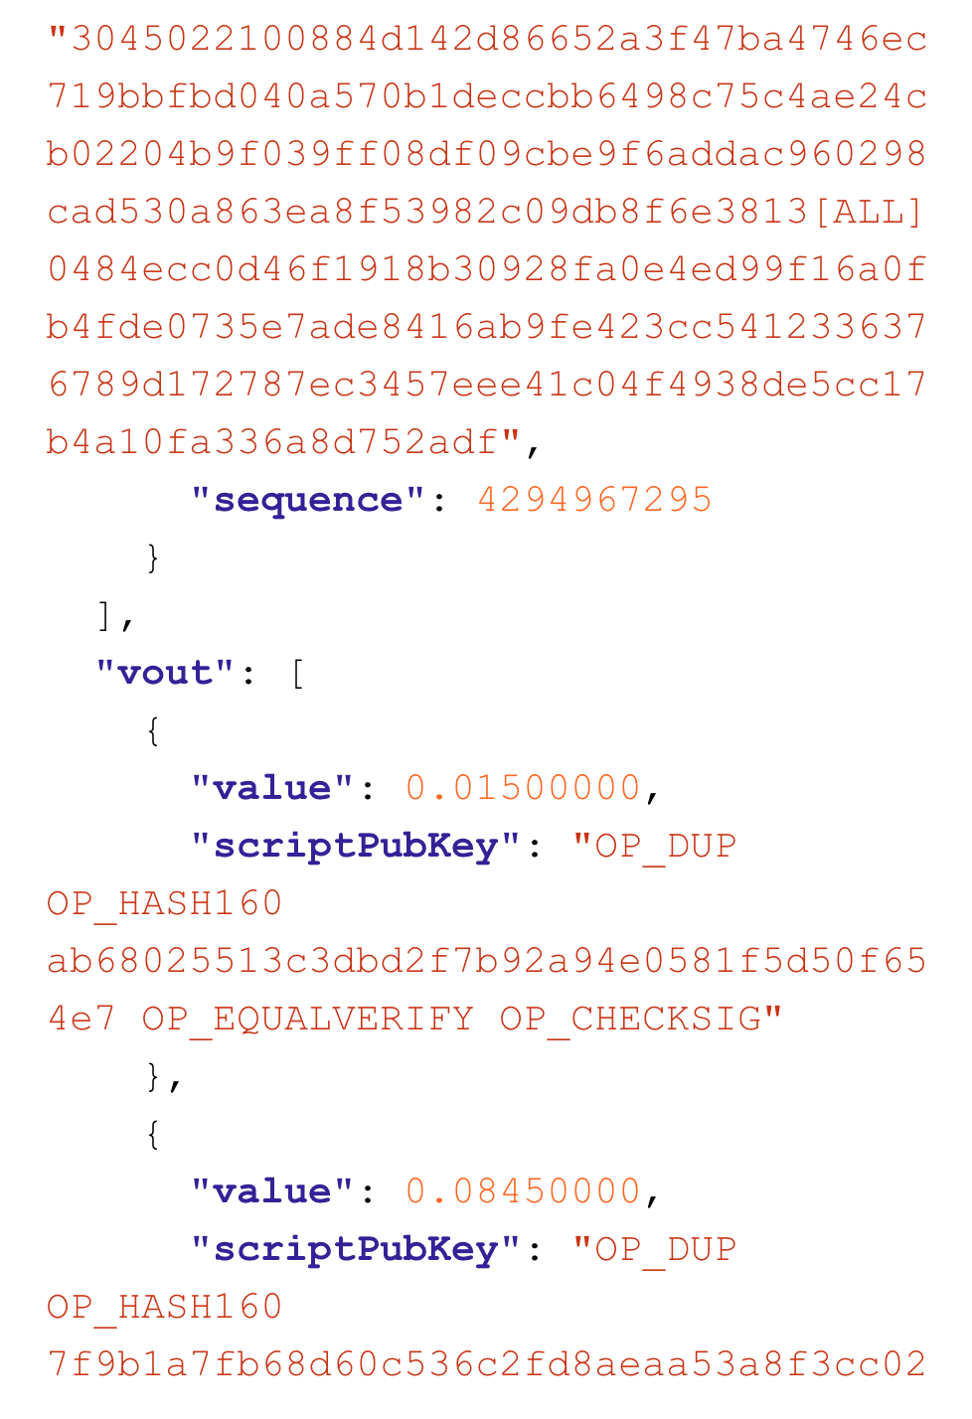
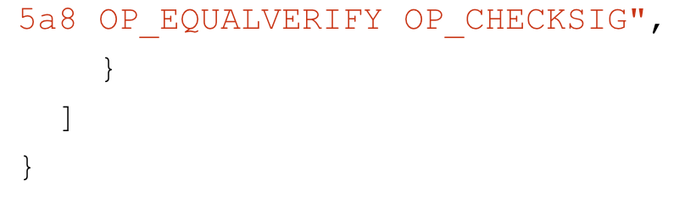
Bitcoin Transaction
Input(s)과 Output(s)으로 구성
Input
Tx id
Output index
Unlocking script
Output
Value
Locking script

Slide 27
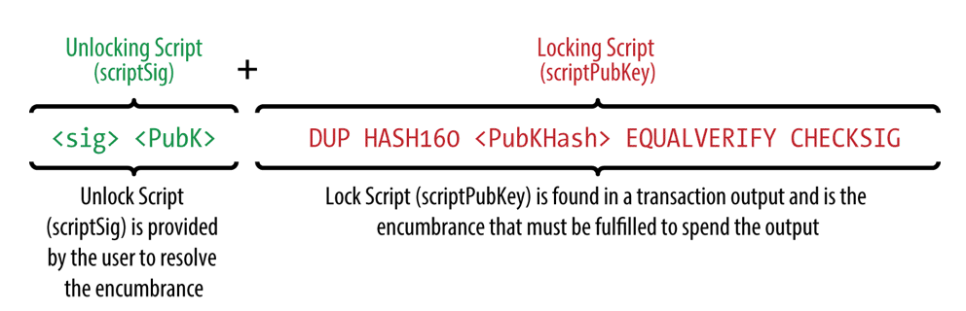
Bitcoin Transaction Script
Script
reverse-polish notation stack-based execution language
P2PKH (Pay to Public Key Hash)

Slide 28
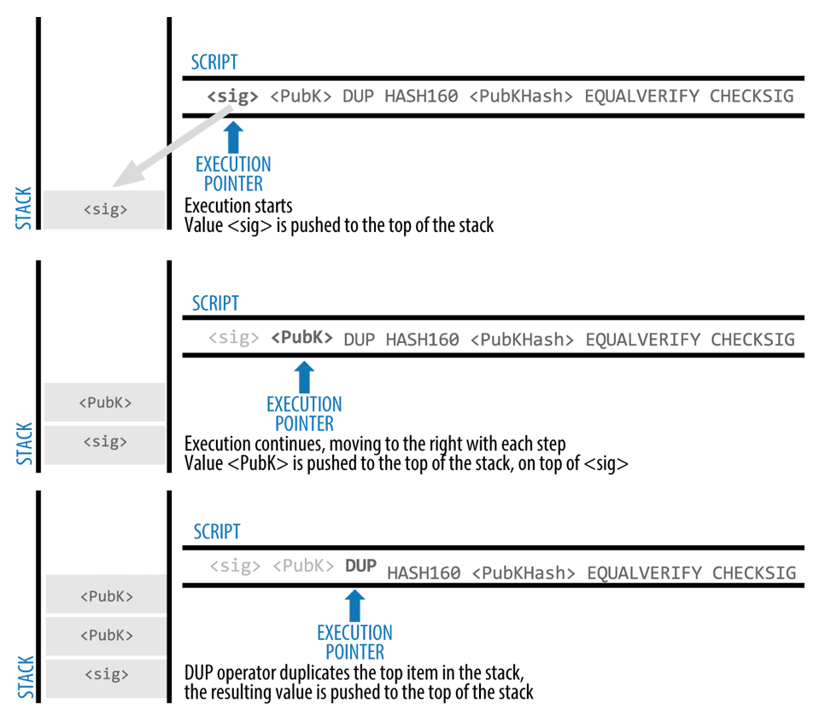
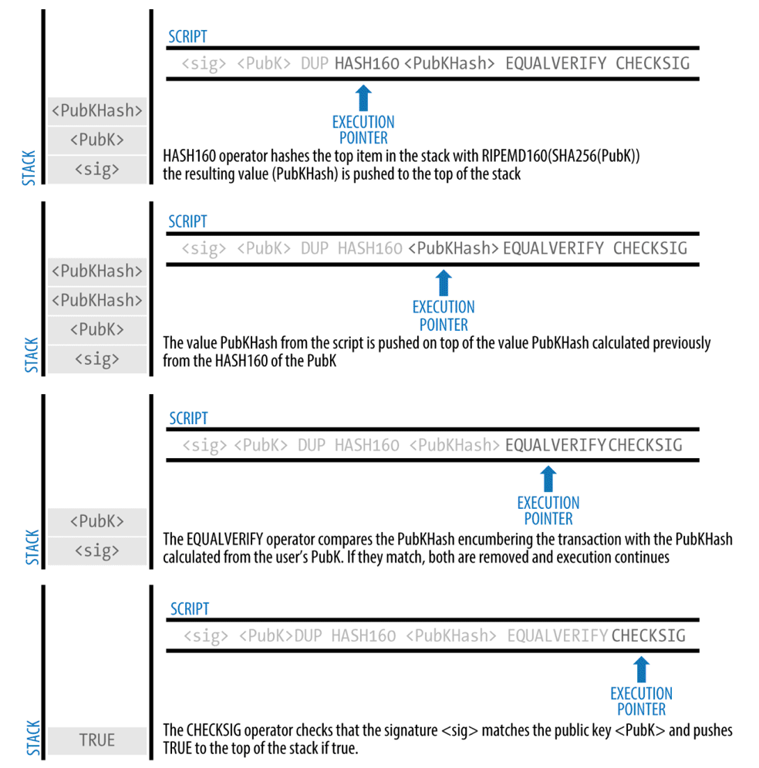
Execution of {Unlock lock} script

Slide 29
Bitcoin Advanced Scripting
Bitcoin can be spend if
Two signs out of three
Or
After 30 days
one and laywer can sign
Or
After 90 days
Laywer can sign

Slide 30
Bitcoin Advanced Scripting
Locking Script
IF
IF
2
ELSE
<30 days> CHECKSEQUENCEVERIFY DROP
<Abdul the Lawyer's Pubkey> CHECKSIGVERIFY
1
ENDIF
<Mohammed's Pubkey> <Saeed's Pubkey> <Zaira's Pubkey> 3 CHECKMULTISIG
ELSE
<90 days> CHECKSEQUENCEVERIFY DROP
<Abdul the Lawyer's Pubkey> CHECKSIG
ENDIF
Unlocking Script
0 <Mohammed's Sig> <Zaira's Sig> TRUE TRUE
Unlocking Script
0 <Saeed's Sig> <Abdul's Sig> FALSE TRUE
Unlocking Script
<Abdul's Sig> FALSE

Slide 31
Limitations of Bitcoin Script
Lack of Turing-completeness
Turing Machine이 풀수있는 문제들을 풀지 못함 (일반적인 컴퓨터가 풀수있는 문제를 못푼다)
Eg: Loop가 없음 (무한루프를 피하기 위해서)
Value blindness
Transaction의 value값 접근이 불가
상황에 따른 지불값 조정이 불가
Block-chain blindness
Block header 정보 접근 불가
Nonce, previous block hash, timestamp 등
Radomeness가 필요한 gaming/gambling 불가

Slide 32
Session 4: Beyond Cryptocurrency

Slide 33
After Bitcoin
Bitcoin in 2009, 2년후(2011) 첫 Altcoin등장, >600 Altcoin until 2017
MatketCap
단위가치 * 총 volume
Bitcoin > Ethereum > Ripple
대부분이 Bitcoin, Litecoin, Ethereum의 fork버전
차이점
Scripting langauge
Transaction관리
추가기능 및 보안기능
Mining여부
Consensus 알고리즘
단순 파라미터 차이

Slide 34
Taxonomy of Altcoins
Purposes
Cryptocurrency-only: Bitcoin
Cryptocurrency & Business logic: Ethereum
Business logic only: Hyperledger
Accessibility
Public block chain
Private block chain
Permissioned (consortium) block chain

Slide 35
Namecoin
Decentralized Domain Name Service
First Altcoin (2011)
Plugin for Chrome/Firefox for “*.bit” website
Cheap (5 cents) for , no cost
Can sell a domain
“Merged mining”

Slide 36
Litecoin
First Memory-hard Mining Puzzle (2011)
Bitcoin: Computation-hard mining puzzle
Block creating every 2.5 minutes (Bitcoin: 10 min)
Second most forked

Slide 37

PeerCoin
First Proof-of-Stake (PoS) Mining Puzzle (2012)
Mining: making transactions using coins
The more unspend coins, the more chance to win
Actually hybrid with PoW
Not fully decentralized
Trusted addresses sign checkpoints

Slide 38
DogeCoin
Just to have fun with Cryptocurrency (2013)
Many marketing compaigns
Random block reward
Each block bonus is random: PRG(prev block hash)
Predictable, so discourages miners when low
Removed after a few months

Slide 39

Monero
Higher privacy level
Bitcoin only supports Pseudonimity
Monero uses “ring signature”
Combination of multiple participants
Fungible coin
Bitcoin can be traced/identified
Monero coin not traceable

Slide 40

Cardano
First provably-secure PoS algorithm: Ouroboros (2015)
Protect user privacy
Now in the top 5 Market Cap
High speed
Layered
Settlement layer: users make exchanges
Control layer: trusted computation framework

Slide 41

Ethereum
First Smart Contract Cryptocurrency (2013)
Smart contracts in Turing-complete language
Multiple smart contracts act a computer program
Installed in the network
Execution fueled by Ether
Allows DApps using Smart Contracts
Topic of this lecture

Slide 42
Session 5: Ethereum Overview

Slide 43
What is Ethereum?
The World Computer
Deterministic, unbounded state machine with
Globally-accessible singleton state
Virtual machine that changes the state
(조금더 쉽게)
globally decentralized computing infrastructure
Executing smart contracts
States are tracked in Blockchain
Cryptocurrency to fuel/constrain execution

Slide 44
Differences from Bitcoin
Interoperability
Bitcoin: reference implementation 제공 (Bitcoin Core)
Ethereum provides reference specification
Yellow paper: 프로토콜의 수학적 정의
다수의 클라이언트 존재: Geth, Parity, …
Purpose
Bitcoin: BTC for digital currency
Ethereum: Ether is utility currency
World Computer인 Ethereum 사용료 지불에 사용
Script
Bitcoin: 지불가능 여부 확인용 간단한 True/False 판단
Ethereum: General-purpose Turing-complete 언어: Solidity

Slide 45
Birth of Ethereum
Bitcoin의 잠재성을 인식한 개발자들은 선택의 기로에 서 있었다
Bitcoin을 기반으로 개발할지
새로운 Blockchain은 만들지
2013년 Vitalik Buterin은 Mastercoin을 확장하려고 하였으나 반대에 부딪쳐 자체개발을 시도
2015년 7월 30일 최초 Ethereum block 생성
A Prehistory of the Ethereum Protocol
https://vitalik.ca/general/2017/09/14/prehistory.html

Slide 46
Ethereum’s Development Plan
(2015.07)
Block #0
State 1:
Frontier
Block #200K
HF: Ice Age
(2016.03)
Block #1150K
Block #1192K
HF: DAO
State 2:
Homestead
Block #2463K
HF: Tangerine Whistle
Block #2675K
HF: Spurious Dragon
(2017.10)
Block #4370K
HF: Byzantium
Now
State 3:
Metropolis
Block #??
HF: Constantinople
Block #??
State 4:
Serenity

Slide 47
Blockchain as a State Machine
Bitcoin
Bitcoin의 Ownership을 관리하는 Distributed State Machine
State transition 는 Ownership을 바꾸는 transaction
State에 대한 consensus를 유지
Ethereum
General-purpose key-value storage의 State transition관리
Like RAM memory
Code & data stored in the memory, run the code, store results in memory
Like Von-Neuman Machine
State transition은 Consensus에 의해 결정됨
State은 globally distributed

Slide 48
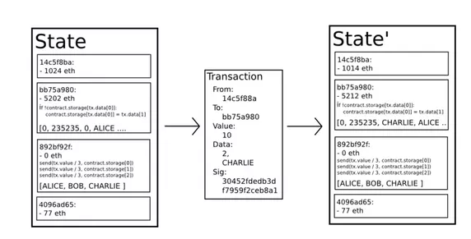
Ethereum State Transition

Slide 49
Ethereum’s Components
Component | Description | Specification
P2P Network | Ethereum Main Network TCP: 30303 | ÐΞVp2p
Consensus rules |  | Yellowpaper
Transactions | Sender, receiver, value, data
State machine | EVM (Ethereum VM), stack-based VM, runs bytecode of smart contract
Data Structures | Store transactions and states (LevelDB) | Modified Merkle Patricia Tree
Consensus Algorithm | Proof-of-Work with longest chain Future: Proof-of-Stake (codename: Casper) | Ethash
Clients | Go-Ethereum (Geth), Parity

Slide 50
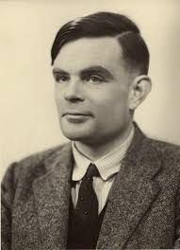
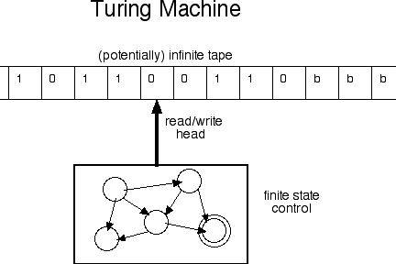
Turing Machine and Completeness
Turing Machine
1936년 Alan Turing이 Turing Machine이라는 모델을 이 모델이 해결할 수 있는 문제를 연구
State machine w/ read-write infinite sequential memory
Halting problem은 풀수없다고 증명
Turing completeness
Turing Machine을 모사할 수 있는 시스템
Universal Turing Machine

Slide 51
Turing Completeness of Ethereum
Ethereum is a Universal Turing Machine
EVM can run a stored program, reading/writing memory
Turing completeness is easy to achieve
Eg: 4-state, 6-symbols, 22-instructions UTM
Turing completeness is dangerous
Halting problem cannot be solved
Impossible to determine if a program will finish
Malicious/Malfunctioning smart contract can hog resources forever
Ethereum’s Solution
EVM consumes gas to run a smart contract’s function
Each instruction has pre-set gas cost
EVM stops execution of a function when no gas left

Slide 52
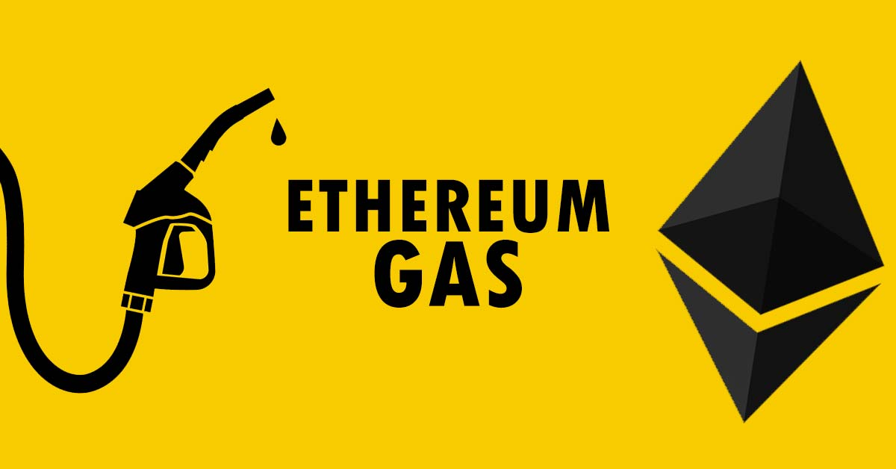
EVM’s fuel: Gas
How smart contract can be run?
Smart Contract를 실행시키는 Transaction은 자신이 지불할 수 있는 최대 gas양을 명시한다
EVM은 미리 정해져있는 gas양을 소모하면서 실행
Gas를 다 썼으면 실행 중지
실행이 완료되면 남은 gas는 돌려준다
How one can buy gas?
Buy gas in a transaction
Transaction은 다음을 표시
수용할 수 있는 unit gas 가격 (gas 가격은 Miner가 결정)
최대 구매 가능한 gas 양

Slide 53
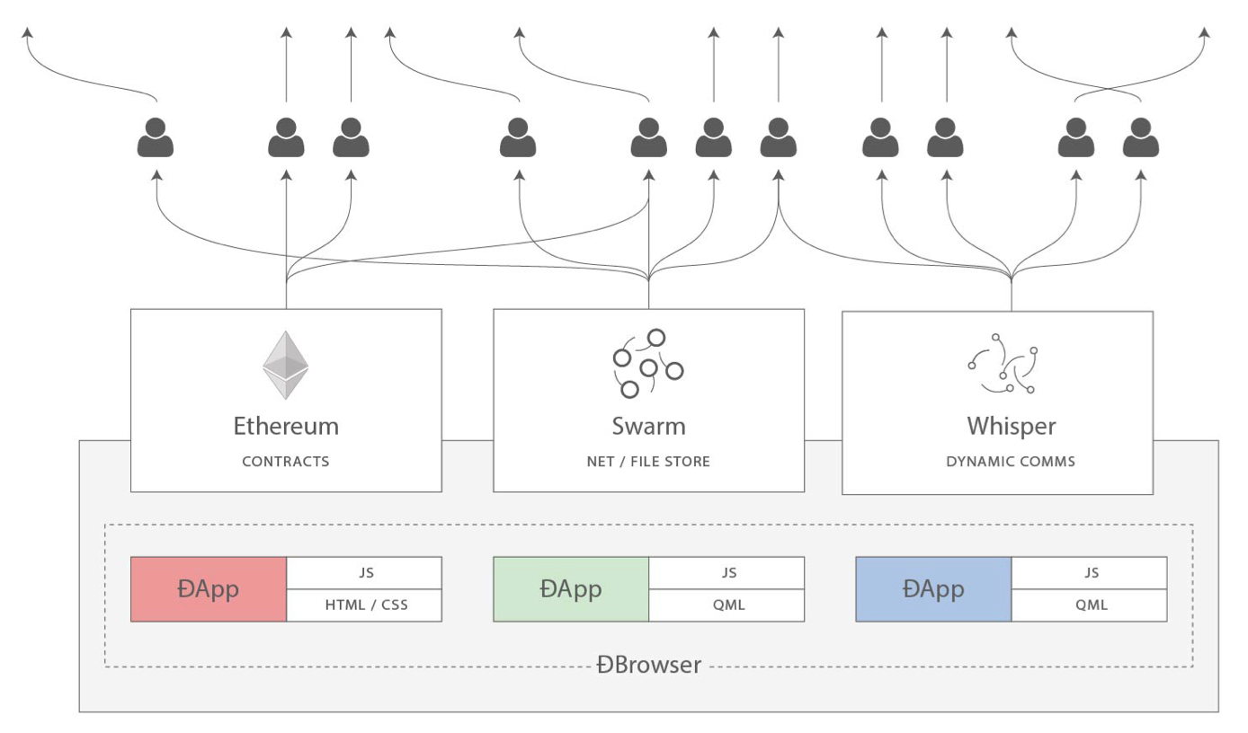
From Blockchain to DApps
Ethereum quickly evolved to
Platform for programming Decentralized Applications
DApp (or ÐApp)
Web application built on blockchain
Smart contract + Web Interface
+ P2P storage + P2P messaging protocol/platform
DApp은 Web 3.0 paradigm
web3.js: Javascript library bridging web app with Ethereum blockchain, interface to Swarm, Whisper

Slide 54
Session 6: Ethereum Basics

Slide 55
Ethereum Current Units
1 ether = 1 ETH = Ξ1 = ♦1
Smallest unit (used in the system): wei = 10⁻¹⁸ETH
Value in wei | Exponent | Common Name
1 | 1 | wei
1,000 | 10³ | babbage
1,000,000 | 10⁶ | lovelace
1,000,000,000 | 10⁹ | shannon
1,000,000,000,000 | 10¹² | szabo
1,000,000,000,000,000 | 10¹⁵ | finney
1,000,000,000,000,000,000 | 10¹⁸ | ether

Slide 56
Ethereum Wallets
Wallet
Ethereum account를 관리해주는 소프트웨어
키쌍생성, 주소생성, 키관리, transaction 생성
Wallet을 바꿀 때
새로운 주소로 ether전송
혹은 key를 export/import
Types
Mobile: Jaxx
Desktop: Jaxx, Emerald
Web: Metamask, MyEtherWallet (MEW)

Slide 57
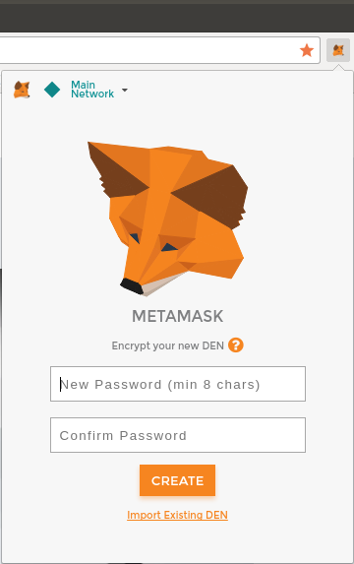
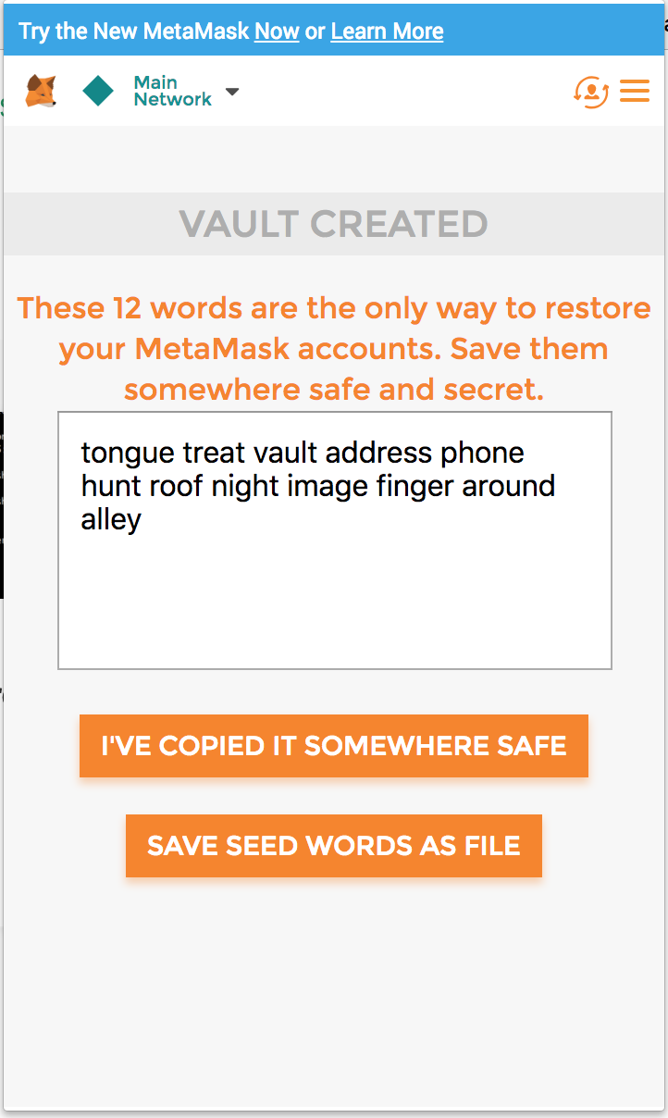
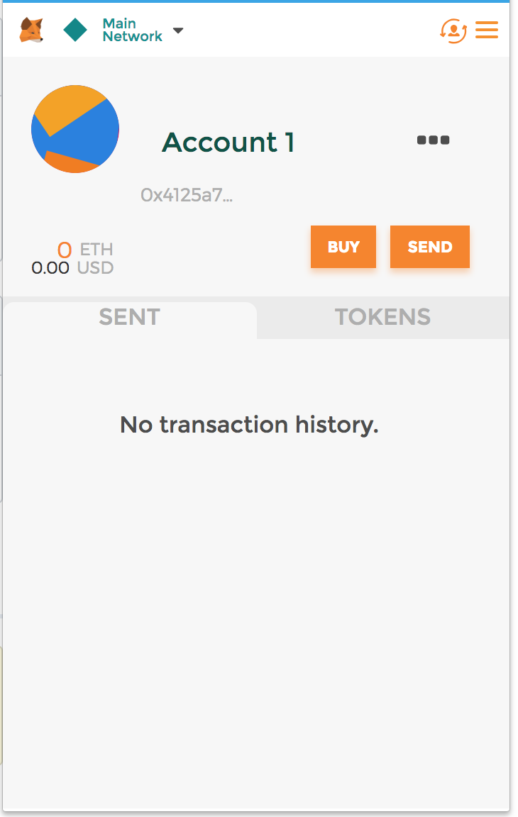
MetaMask
Installation as browser extension
https://chrome.google.com/webstore/detail/metamask/nkbihfbeogaeaoehlefnkodbefgpgknn
Inject web3 API into every website's javascript context, so that dapps can read from the blockchain
Be carefule about your privacy
Enter a password
Then, 키쌍 생성
Mnemonic 생성→안전하게 보관
Mnemonic: 12개의 단어, wallet 복구에 사용됨
하나의 키쌍으로 모든 네트워크에 참여

Slide 58
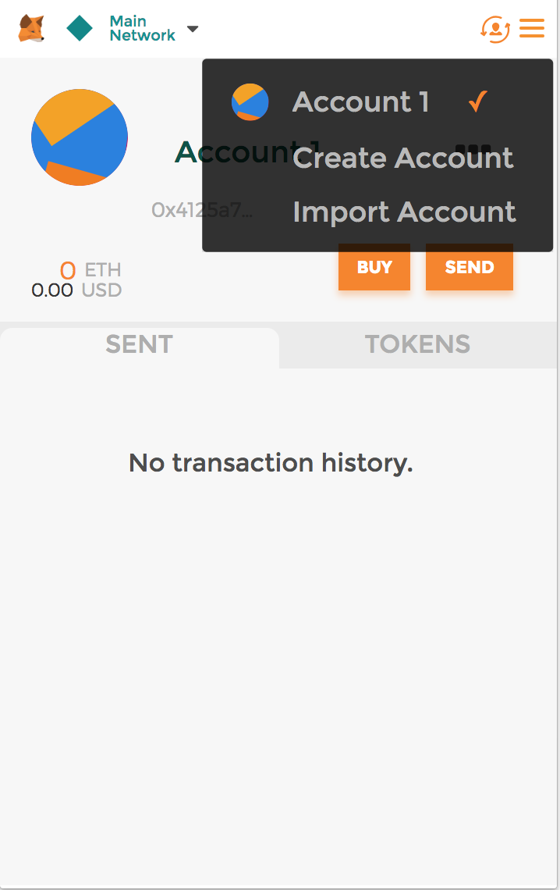
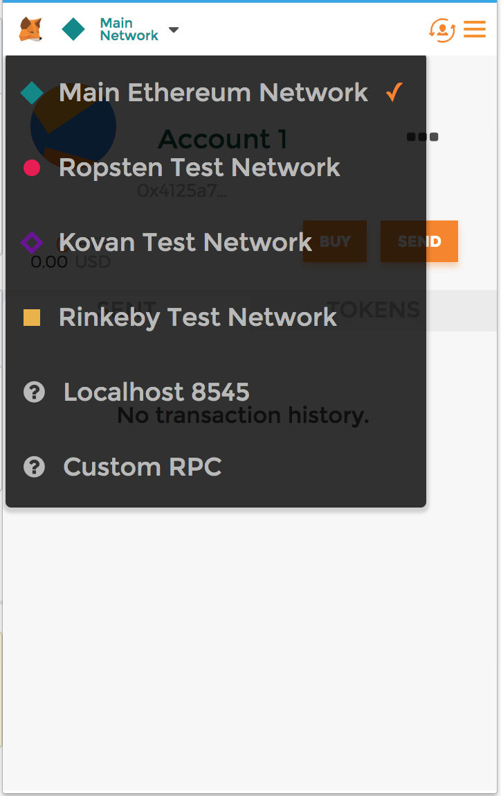
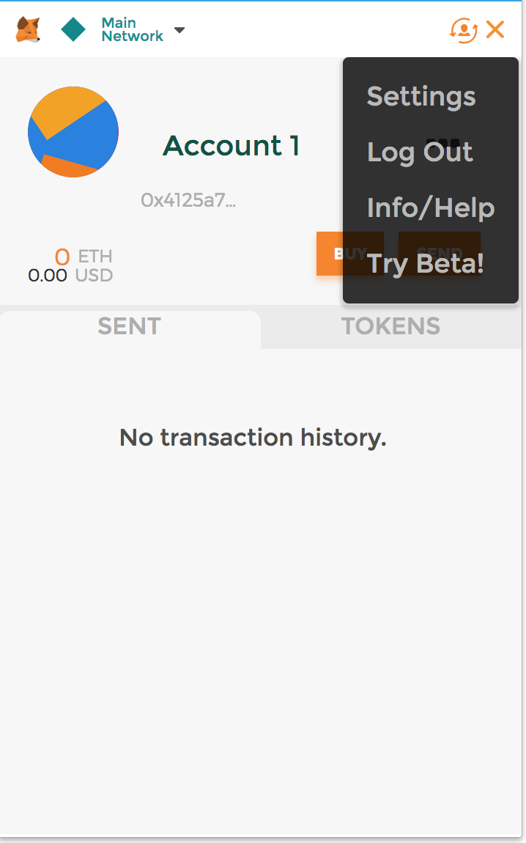
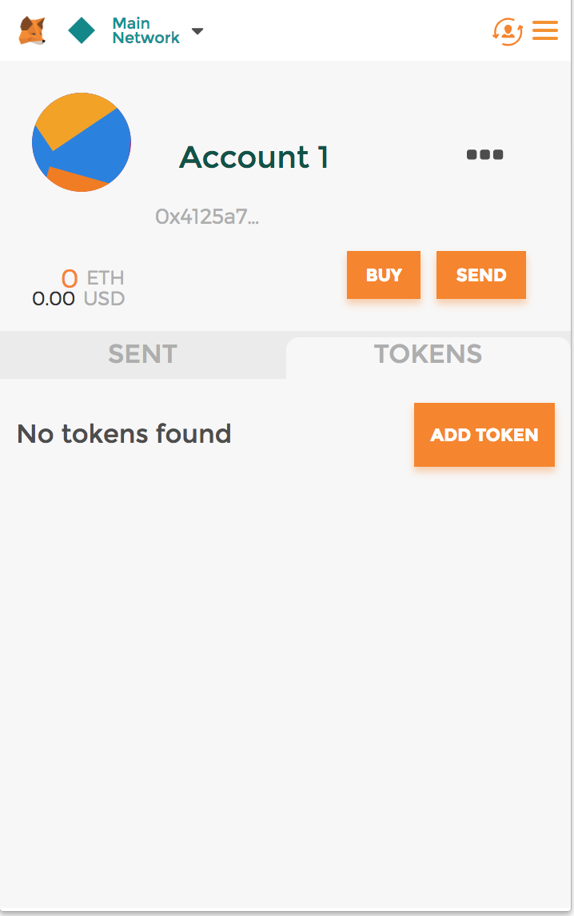
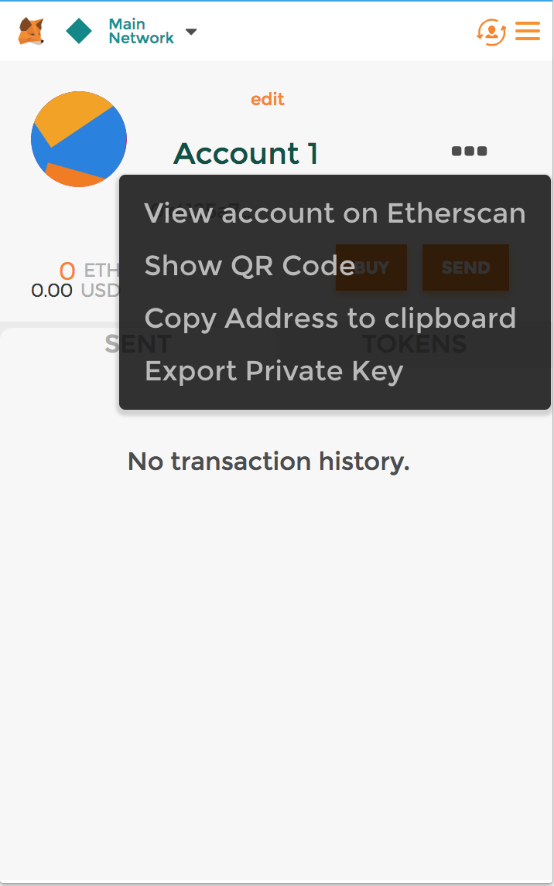
MetaMask
Interface

Slide 59
Switching Networks
Main Eth. Network | The real Ethereum network with real money
Ropsten Test Network | Public test blockchain. Not real money
Kovan Test Network | Public test blockchain. Proof-of-Authority using Aura. Supported by Parity client only
Rinkeby Test Network | Public test blockchain. Proof-of-Authority using Clique
Localhost 8545 | Connect to a local node (either main, testnet or private)
Custom RPC | Connect to a node thru Geth-compatible RPC

Slide 60
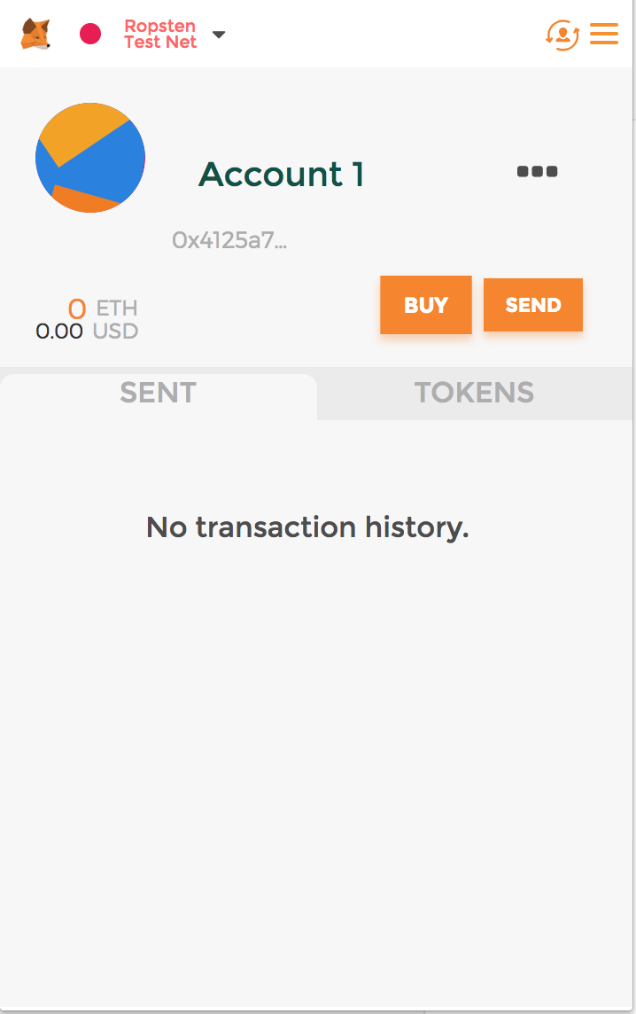
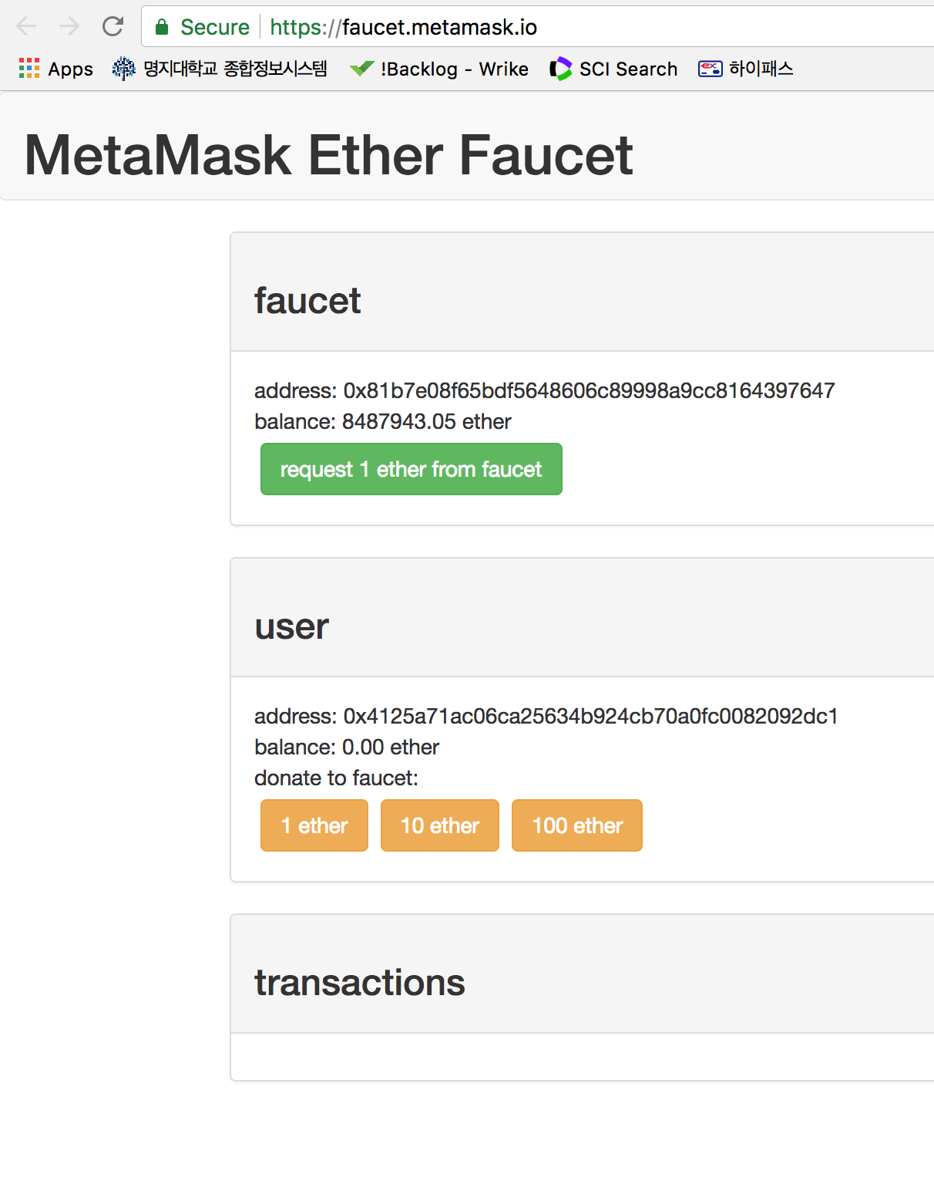
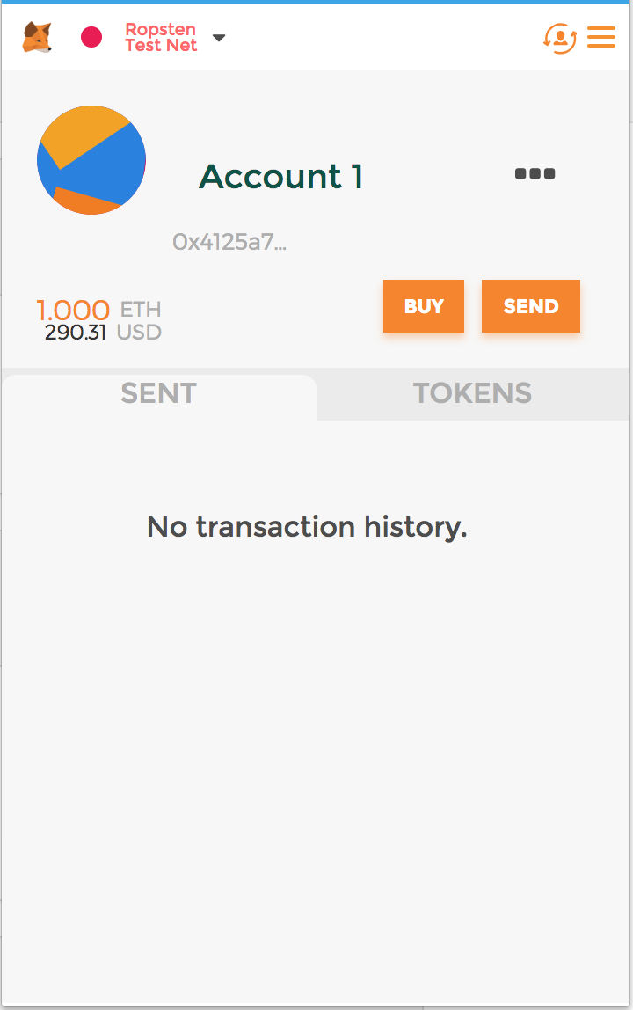
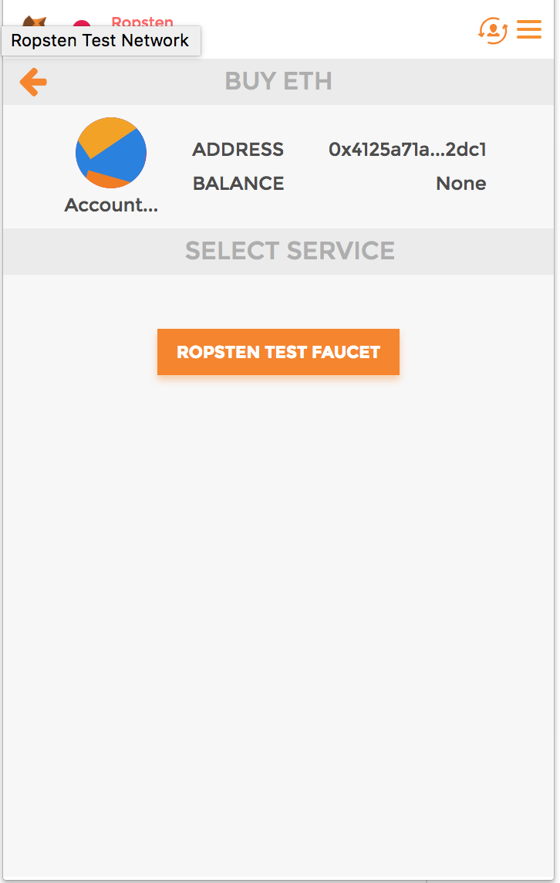
Get Funded
Get ether from faucet of the testnet
Click “Buy” with Ropsten testnet → Faucet DApp
Check the transaction in etherscan.io
한번에 1 ether 구매가능(무료)

Slide 61
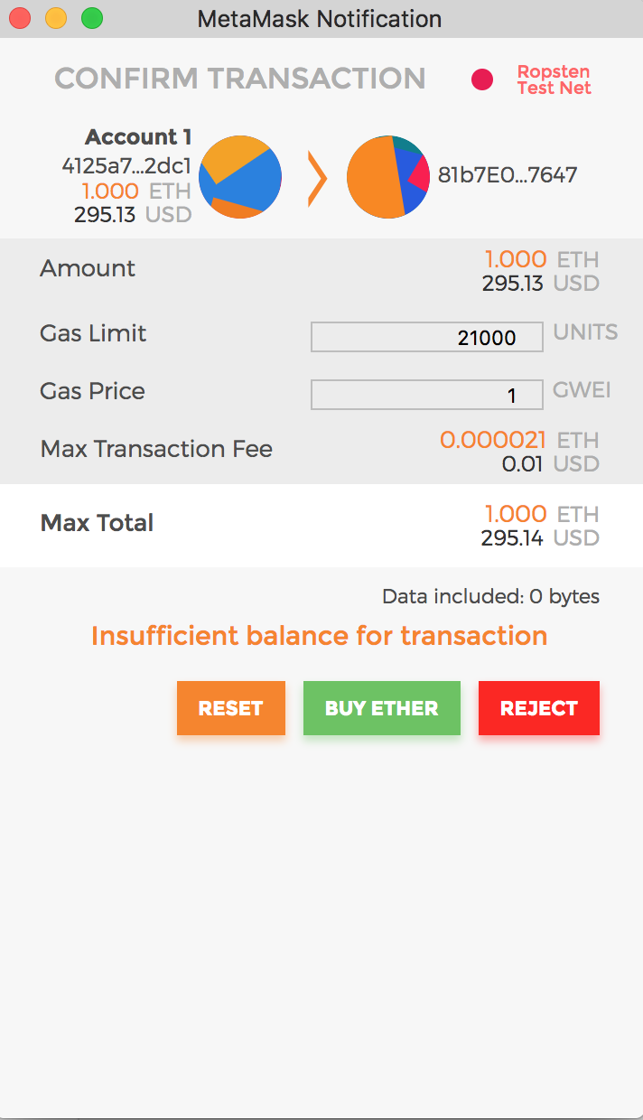
Send back (donate)
Give ether back to faucet
Click “1 ether”
Why insufficient?
No ether for gas payment
We need 1.000021 ether
21000 gas for sending a transaction
Get more fund (1 ether)
Try again

Slide 62
EOA and Contracts
Externally Owned Account (EOA)
Wallet-generated account with private key behind
Contract account
Has smart contract code
No private key
Can send/receive ether
Transaction sent to contract account will trigger code execution with input in data
Cannot initiate a transaction, but
Can react to transactions and interact with other contracts

Slide 63
The first Smart Contract: Faucet
Faucet smart contract는 요청된 ether를 제공하고 전송된 ether를 수신하는 가장 간단한 smart contract
Faucet
withdraw(amount): 1ether이하 요청금액을 sender에게 전송
()
: anonymous callback 함수. 돈을 수신하면 불림
EOA
Faucet
Tx
Amount=1ether
1 ether

Slide 64
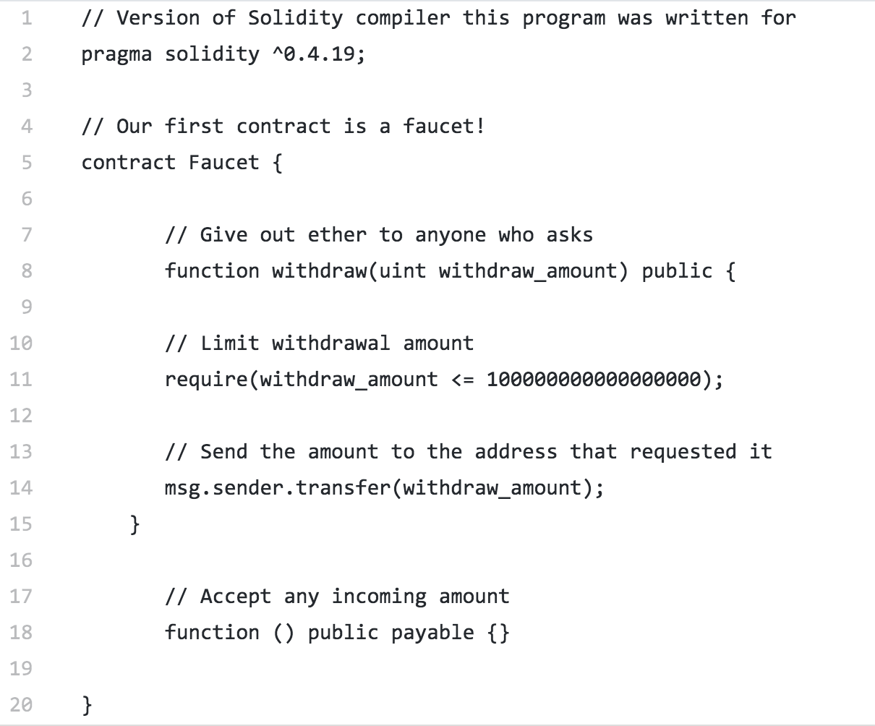
The first Smart Contract: Faucet

Slide 65
Compilation using Remix
https://remix.ethereum.org/
Create faucet.sol & fill it
Compile
Check the details to see bytecode and others

Slide 66
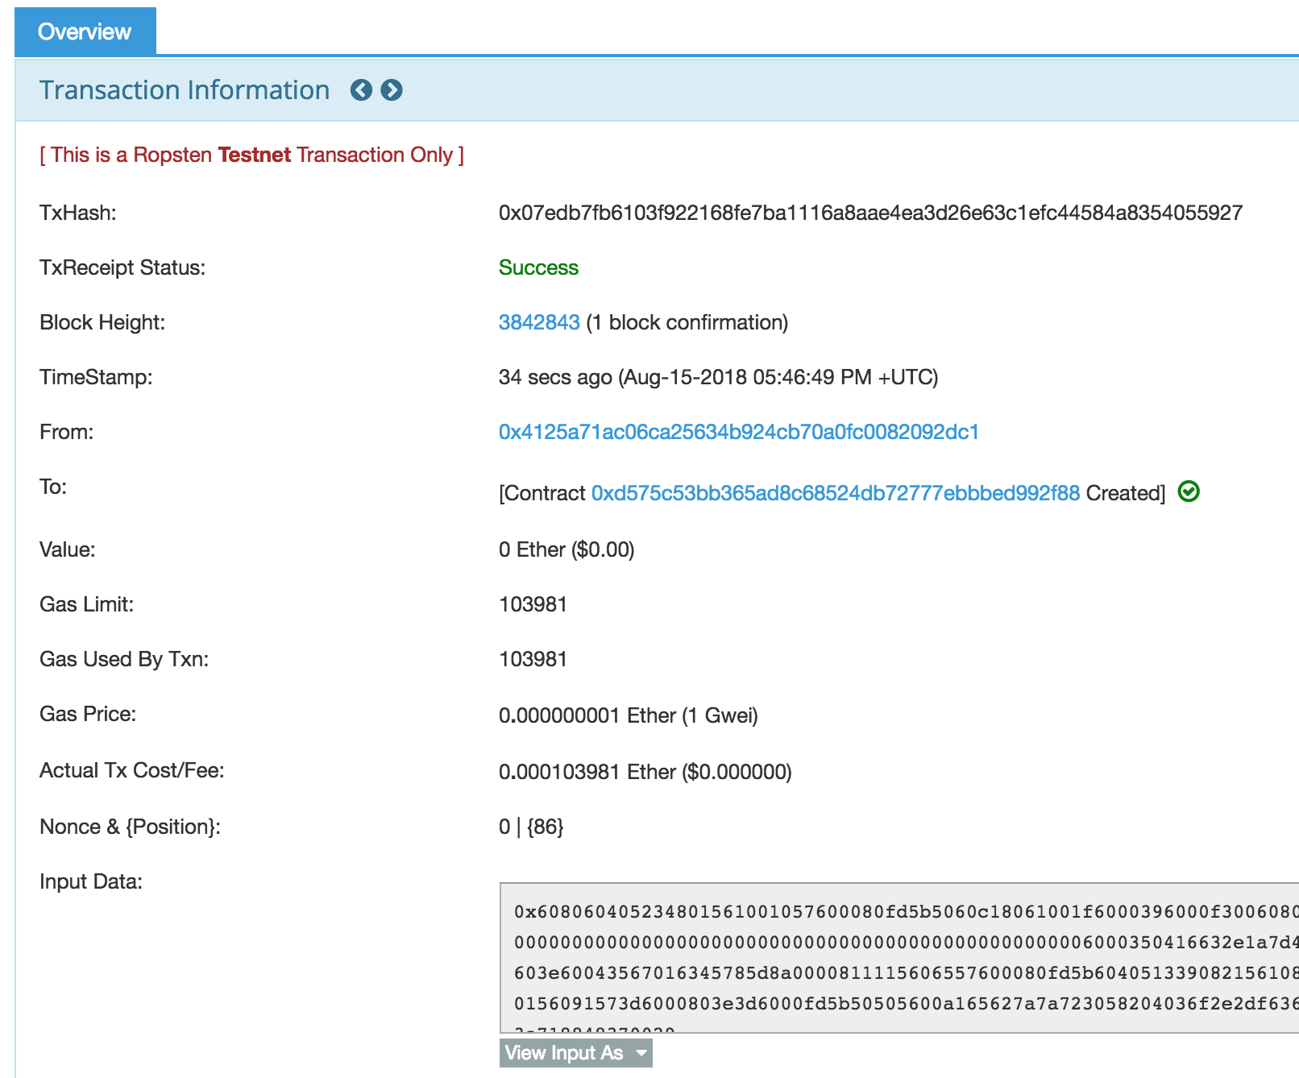
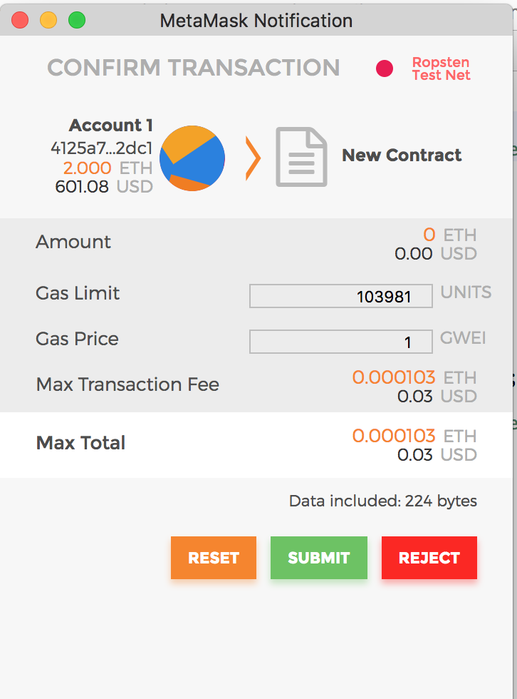
Register Smart Contract on BC
To register a contract on the block chain
Create a special transaction
Destination address: 0x0 (zero)

Slide 67
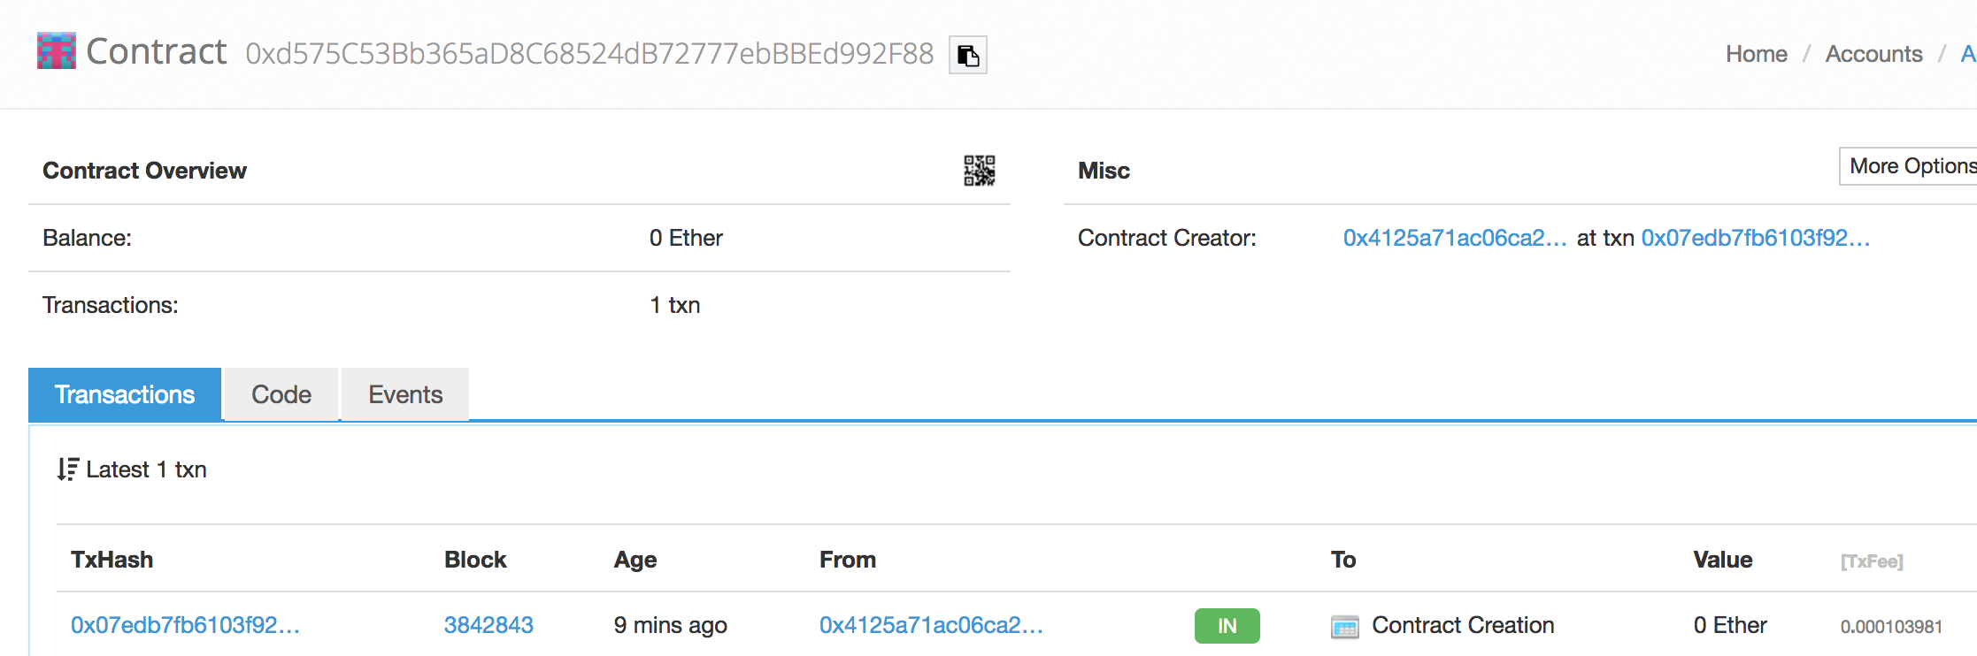
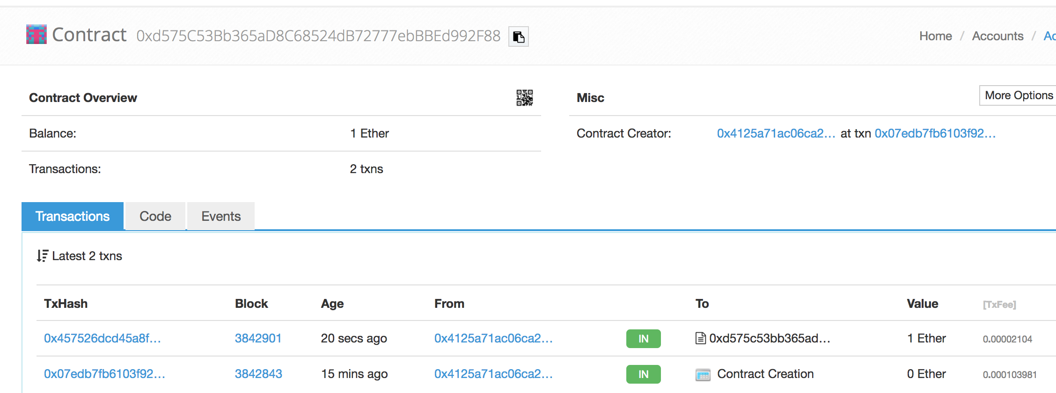
Interact with Contract
Lookup contract by address at ropsten.etherscan.io
Send 1 ether to Faucet contract

Slide 68
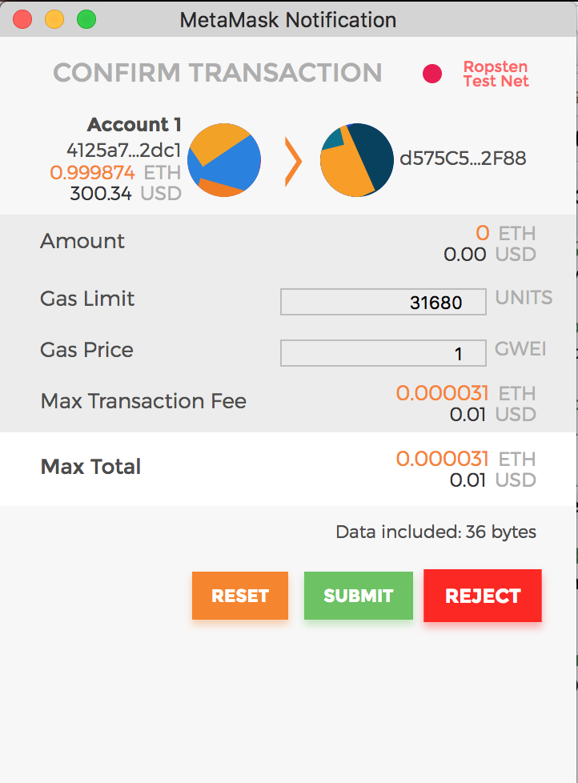
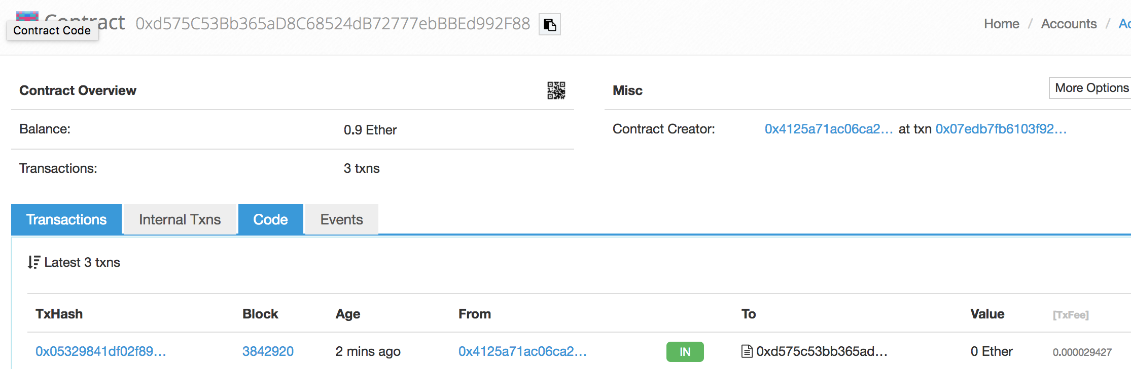
Interact with Contract
Withdraw 0.1 ether

Slide 69
Session 7: Ethereum Clients

Slide 70
Ethereum Client
Software that implements Ethereum specifications
Yellow paper: formal(mathematical) specification
Ethereum Improvement Protocol (EIP)
Ethereum Request for Comments (ERC)
다양한 Client가 존재
Parity in Rust
Geth in Go
Cpp-ethereaum in C++
Pyehtereum in Python
Mantis in Scala
Harmony in Java

Slide 71
Ethereum Netoworks
Ethereum specification을 따르지만 호환되지 않는 네트워크
Ethereum
Ethereum Classic
Ella
Expanse
Ubiq
Musicoin
…

Slide 72
Running a Full Node?
Running a full node costs
>80GB storage, sync in several days
For development
Run testnet node
<10GB, sync in a few hours
Run local private node (Ganache)
Instantly works, no other user, no other contract
Run cloud-based Ethereum client
Run remote client (Remix) switching different nodes/networks
Fast synchronization
Download blocks, but defer validation

Slide 73
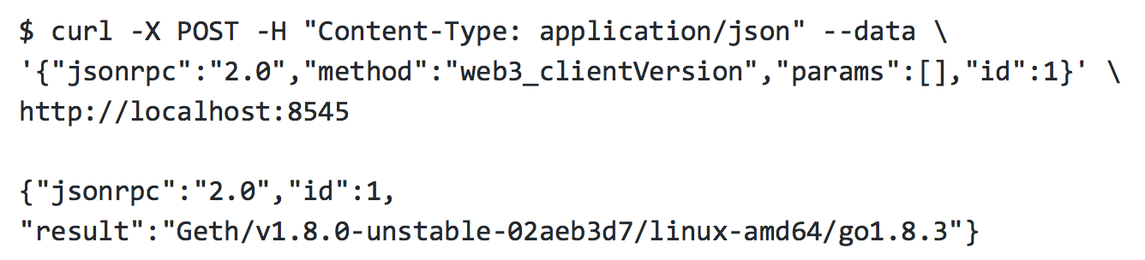
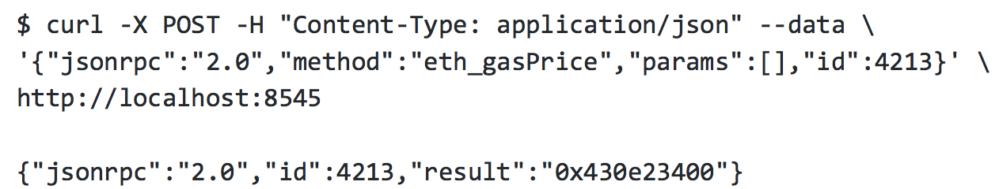
JSON-RPC interface
Ethereum client가 제공 (over HTTP on port 8545)
JSON-RPC 2.0 spec (www.jsonrpc.org/specification)
https://github.com/ethereum/wiki/wiki/JSON-RPC
JSON-RPC API는 개발자가 Ethereum Client를 통해서 blockchain에 접근할 수 있게 해준다

Slide 74
Session 8: Ethereum Addresses

Slide 75
How to generate an Address
Key-pair generation
Private key: random 256bit number in certain range
F8f8a2f43c8376ccb0871305060d7b27b0554d2cc72bccf41b2705608452f315
Public key: uncompressed, 04|x|y (65bytes)
046e145ccef1033dea239875dd00dfb4fee6e3348b84985c92f103444683bae07b83b5c38e5e2b0c8529d7fa3f64d46daa1ece2d9ac14cab9477d
Address format
Last 20 bytes of Keccak256 hash of public key
No checksum
ICAP (Inter Exchange Client Address Protocol) like IBAN (International Bank Account Number) is not used much
EIP-55: backward compatible capitalization-based checksum

Slide 76
EIP-55: Capitalization-based Checksum
From-to
F=001d3f1ef827552ae1114027bd3ecf1f086ba0f9
T=001d3F1ef827552Ae1114027BD3ECF1f086bA0F9
H=Keccak256(F)
T[i] = Upper(F[i]) if H[i] ≥ 8
H=23a69c1653e4ebbb619b0b2cb8a9bad49892a8b969..
F=001d3f1ef827552ae1114027bd3ecf1f086ba0f9
T=001d3F1ef827552Ae1114027BD3ECF1f086bA0F9
How to check
Given T, F=Lower(T), generate H=K(F), check if T is right
Detect error with 99.986%

Slide 77
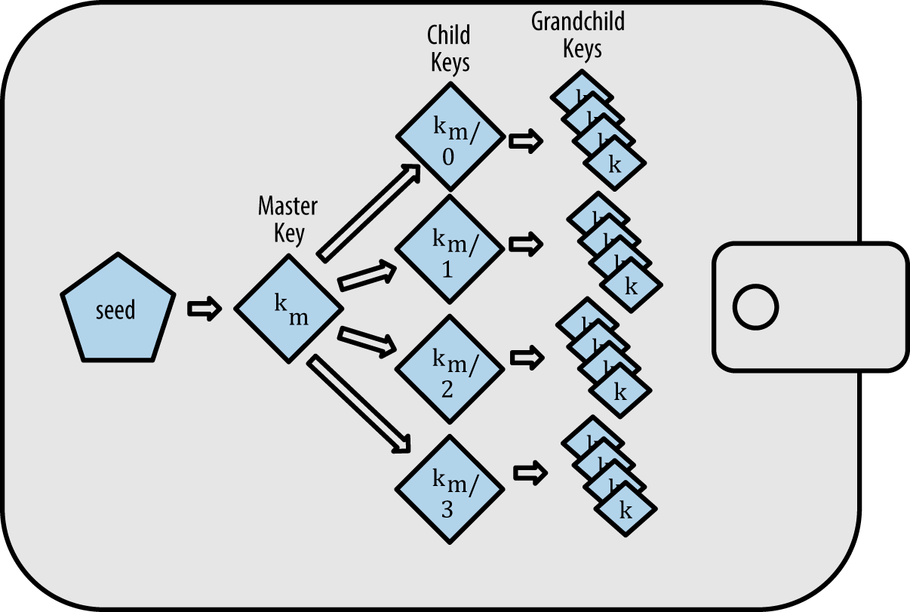
Key management of Wallet
Two types of key management in Wallet
Nondeterministic wallet (JBOK wallet)
A set of unrelated keys stored
Deterministic wallet
All keys are derived from a master key (seed)
Hierarchical Deterministic (HD) wallet: uses tree (BIP-32)

Slide 78
Seeds and Mnemonic (BIP-39)
Compute mnemonic words from a seed
Which one is easier to write down correctly?
Seed
FCCF1AB3329FD5DA3DA9577511F8F137
12 Mnemonic words:
wolf juice proud gown wool unfair wall cliff insect more detail hub
When creating new HD wallet
Picks a random number (128~256)
Generates 12~24 mnemonic words
Derive root seed from those words
Derive all other keys
https://iancoleman.io/bip39/

Slide 79
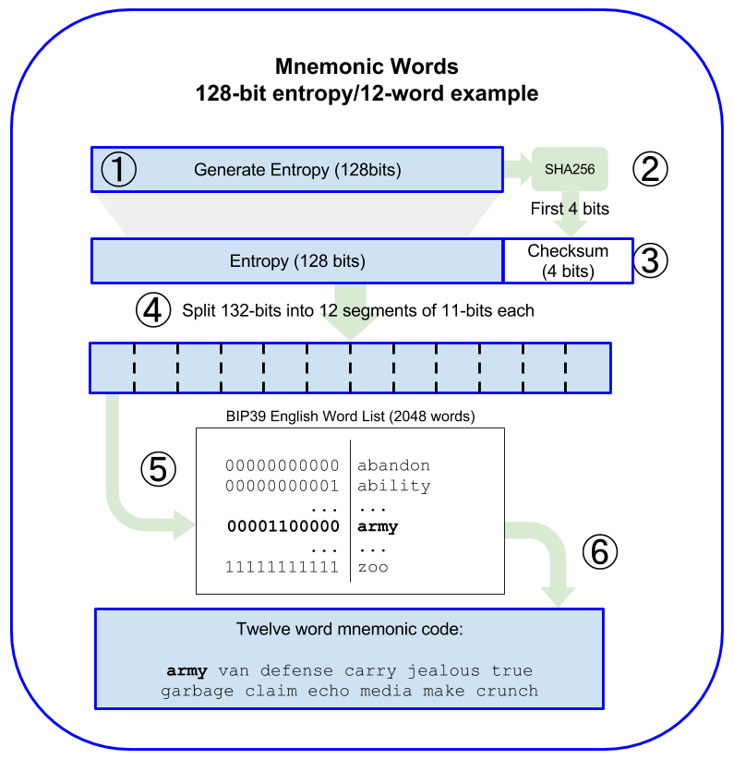
Generate Mnemonic Words
128-bit seed
Checksum 4bits
→12 words
256-bit seed
Checksum 8bits
→24 words
Your choice of 12 words won’t work

Slide 80
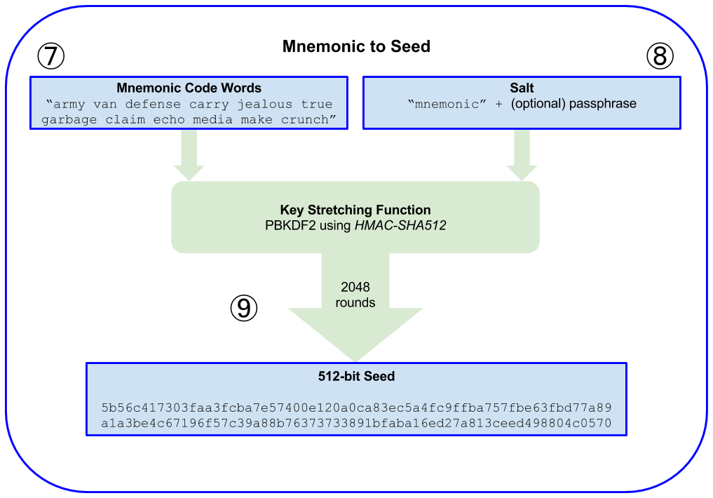
Derive Seed from Mnemonic words

Slide 81
Session 9: Transactions

Slide 82
Transaction
Signed message from EOA, trigger state change or contract execution (nothings run in background)
Transaction 구조
Nonce: sequence no among tx from the same EOA
Gas price: how much willing to pay
Gas limit: maximum gas to use
To: destination address
Value: ether to transfer
Data: payload to trigger contract function
ECDSA signature (v,r,s)
Serialization by Recursive Length Prefix (RLP)
All numbers in big-endian, multiple of 8 bits
From address is derived from (v,r,s)

Slide 83
Recursive Length Prefix (RLP)
Compact serialization of items and list of items
Each value/list is prefixed by one or zero 1-byte prefix
Depending on the range of the prefix, what follows is determined
It can express any number of nested lists
The following encoding format depends on the range of the prefix
If val in [0,0x7f], no prefix
If len(val) >=56
Prefix=0xB8+len(len(val))|len(val)
If len(list) >=56
Prefix=0xC8+len(len(list))|len(list)
If len(val) <=55,
Prefix=0x80+len(val)
If len(list) <= 55,
Prefix=0xC0+len(list)
0
80
B8
C0
C8
FF

Slide 84
Transaction.nonce
The number of transactions sent & confirmed from this address (like sequence number)
It should be unique (duplicate not allowed)
If a nonce is missing, all tx with larger nonces are pending
Nonce makes the hash of tx’s with identical content different

Slide 85
Transaction Gas
Gas 는 별개의 virtual currency이미 ether와 환율이 존재
Ether의 변동가치와 resource cost의 변화때문
https://ethgasstation.info
Tx.gasPrice: Tx 생성자가 받아들일 수 있는 최대 gas환율
높을수록 빨리 confirm 될 가능성이 있음
Web3 는 최근 블록들에 추가된 gasPrice의 median값을 알려줌
Tx.gasLimit: Tx 생성자가 구매할 최대 gas양
Simple transaction with no computation: 21,000 gas

Slide 86
Transaction.data
Data payload = <function selector> | <parameters>
<function selector> = first 4 bytes of Hash(<func prototype>)
<func prototype> = <func name>(<arg types>)
<parameters> = <param>|….|<param>
<param>=big-endican representation of the parameter
Ex: “function withdraw(uint amnt) public {“
<func selector>: SHA3(“withdraw(uint256)”)’s first 4 bytsee
0x2e1a7d4d13322e7b96f9a57413e1525c250fb7a9021cf91d1540d5b69f16a49f
<params>=0…02386f26fc10000 (for 0.01 ether)
Payload = 2e1a7d4d0…02386f26fc10000

Slide 87
Smart Contract Creation
Special transaction for contract creation
Sent to 0x0 address (indicating “create this contract”)
Free
Special ether-burning address: 0xDEAD
Data payload=<bytecode>
solc --bin Faucet.sol
code=“0x606…”;
web3.eth.sendTransaction( {from: <myaddr>, to: 0, data: code, gas: 113558, gasPrice: 200000000000} )

Slide 88
Transaction prapagation
Transaction is broadcast to neighbors
Upon receiving, node validates it
Forward to other nodes (among >=13 neighbors)
It take a few seconds to flood the entire network

Slide 89
Session 10: Smart Contract

Slide 90
What is Smart Contract
Nick Szabo coined in 1990
Original meaning is a bit different from what we use now
Definition
immutable computer programs that run deterministically in EVM on the decentralized world computer
Contract’s address
Last 20 bytes of Keccak256(RLP(sender, nonce))

Slide 91
Lifecycle of Smart Contract
Source
compile
Bytecode
Block #234
EOA
deploy
Tx → #0
Tx → #0
Bytecode
Bytecode
Block #897
EVM
SC #999
Tx → #678
Gas=100
call
EOA
send
call
Smart
Contract #678
Foo( “hi” )
Left gas = 30
(internal tx)

Slide 92
ETC about Smart Contract
스스로 실행되지 않는다 (반드시 trigger하는 tx가 필요)
백그라운드 실행 불가
Concurrent 실행 불가 (single threaded)
Atomic 실행 (all or nothing)
성공하면 새로온 state기록, 아니면 rollback (revert)
한번 설치되면 수정할 수 없다
다만, 삭제 가능
Run SELFDESTRUCT opcode of EVM
Gas is refunded
Code and internal states are removed
하지만, 프로그래머가 delete기능을 프로그램 해 놔야 함

Slide 93
Session 10: Tokens

Slide 94
Token
Blockchain-based abstractions that can be owned and represent assets, currency, or access rights.
Can be exchanged, multipurpose
Use of token for
Currency
Resource
Asset
Access
Equity
Voting
Collectible
Identity
Attestation
Utility

Slide 95
Fungible & Non-fungible Tokens
Fungible: 재화가 같은 종류의 재화와 본질적으로 대체가 가능한 경우
기름, 현금, 금,…
Non-fungible: 각 재화가 고유의 가치가 있어서 교환이 불가능
애완견, 수집물, 비트코인
추적이 가능하면 Non-fungible
Non-fungible token: 미술품 토큰, CryptoKitty

Slide 96
Intrinsicality of Tokens
Tokens that represent extrinsic things
Real estate, corporate shares, trade marks, gold bars
Ownership is not within blockchain; by law & custom
There exists counterparty risk
Tokens that represent intrinsic things
CryptoKitty
Ownership is governed by blockchain consensus rules
Blockchain convert extrinsic assets into intrinsic ones
Moving equity in corporation to voting tokens in a decentralized autonomous organizations (DAO)

Slide 97
Utility or Equity
Limitations of “tokenize everything” approach
Most Ethereum projects involves tokens
Either utility token or equity token, or both
Utility token
Access rights to a service, application, resource
Equity token
Shares in the control/ownership of something
Voting shares in a DAO
Some disguisingly use equity tokens as utility tokens

Slide 98
Tokens in Ethereum
Ethereum 이전부터 token은 존재
Bitcoin is token itself
Many token platform existed before Ethereum
Ethereum의 Token standard 이후로 폭발적 증가
Token은 Ethereum protocol이 인식하지 못하고 smart contrat 레벨에서 개발자가 임의로 구현함
Token Standard는 개발자가 안전하게 토큰을 구현할 수 있게 해줌

Slide 99
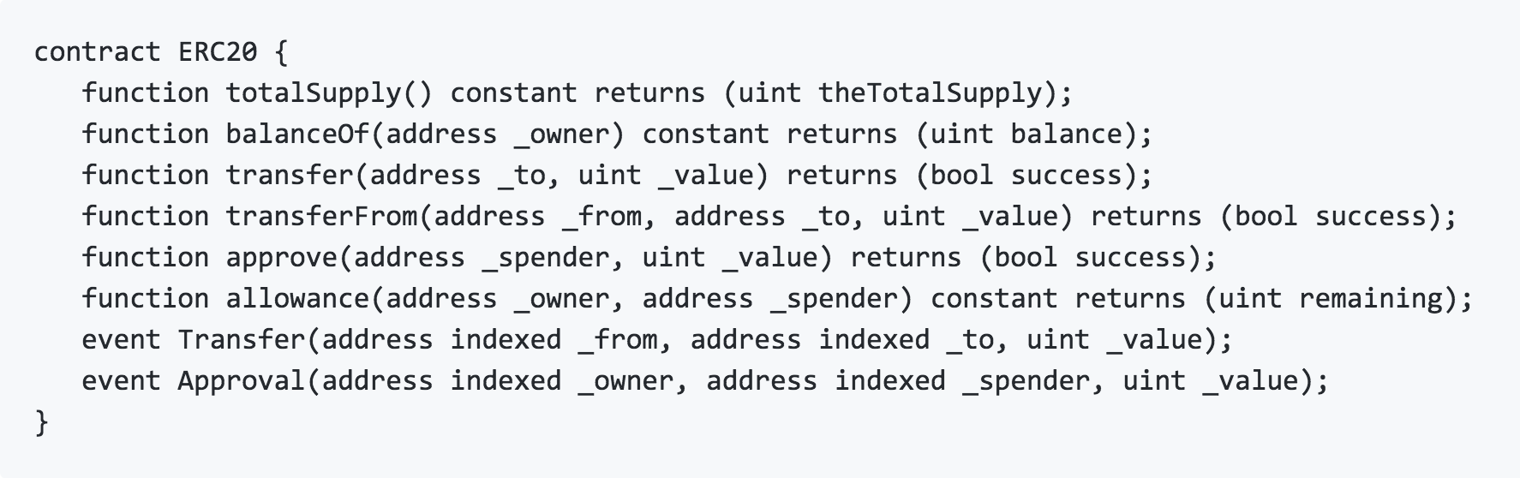
ERC-20 for Fungible Token
Introduced in Nov 2015, now EIP-20
https://github.com/ethereum/EIPs/blob/master/EIPS/eip-20.md
Standard for fungible tokens
different units of an ERC20 token are interchangeable and have no unique properties
Defines
Common interface for fungible token’s contracts

Slide 100
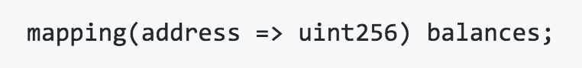
ERC-20 for Fungible Token
Data structures
Balances: given address, store the balance
Allowances: given owner, given spender, store allowance
Workflows for “A→B: 10 tokens”
Single-transaction: token.transfer(B, 10)
Two-transaction: approve → transferFrom
Delegate distribution/control of tokens to contract

Slide 101
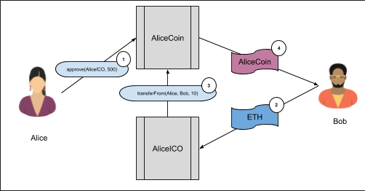
Selling tokens for ICO
ICO: Initial Coin Offering
Sell limited number of tokens to those who buy tokens
Steps
Alice creates AliceCoin ERC-20 contract
Assign all tokens to Alice
Alice creates AliceICO contract
Alice calls AliceCoin.approve(AliceICO, <total>)
When AliceICO receives ether from Bob, calls AliceCoin.transferFrom(Alice, Bob, <amnt>) (Bob receives <amnt> tokens from AliceCoin)
Implementations of EIP-20 contract
Consensys: https://github.com/ConsenSys/Tokens/blob/master/contracts/eip20/EIP20.sol

Slide 102
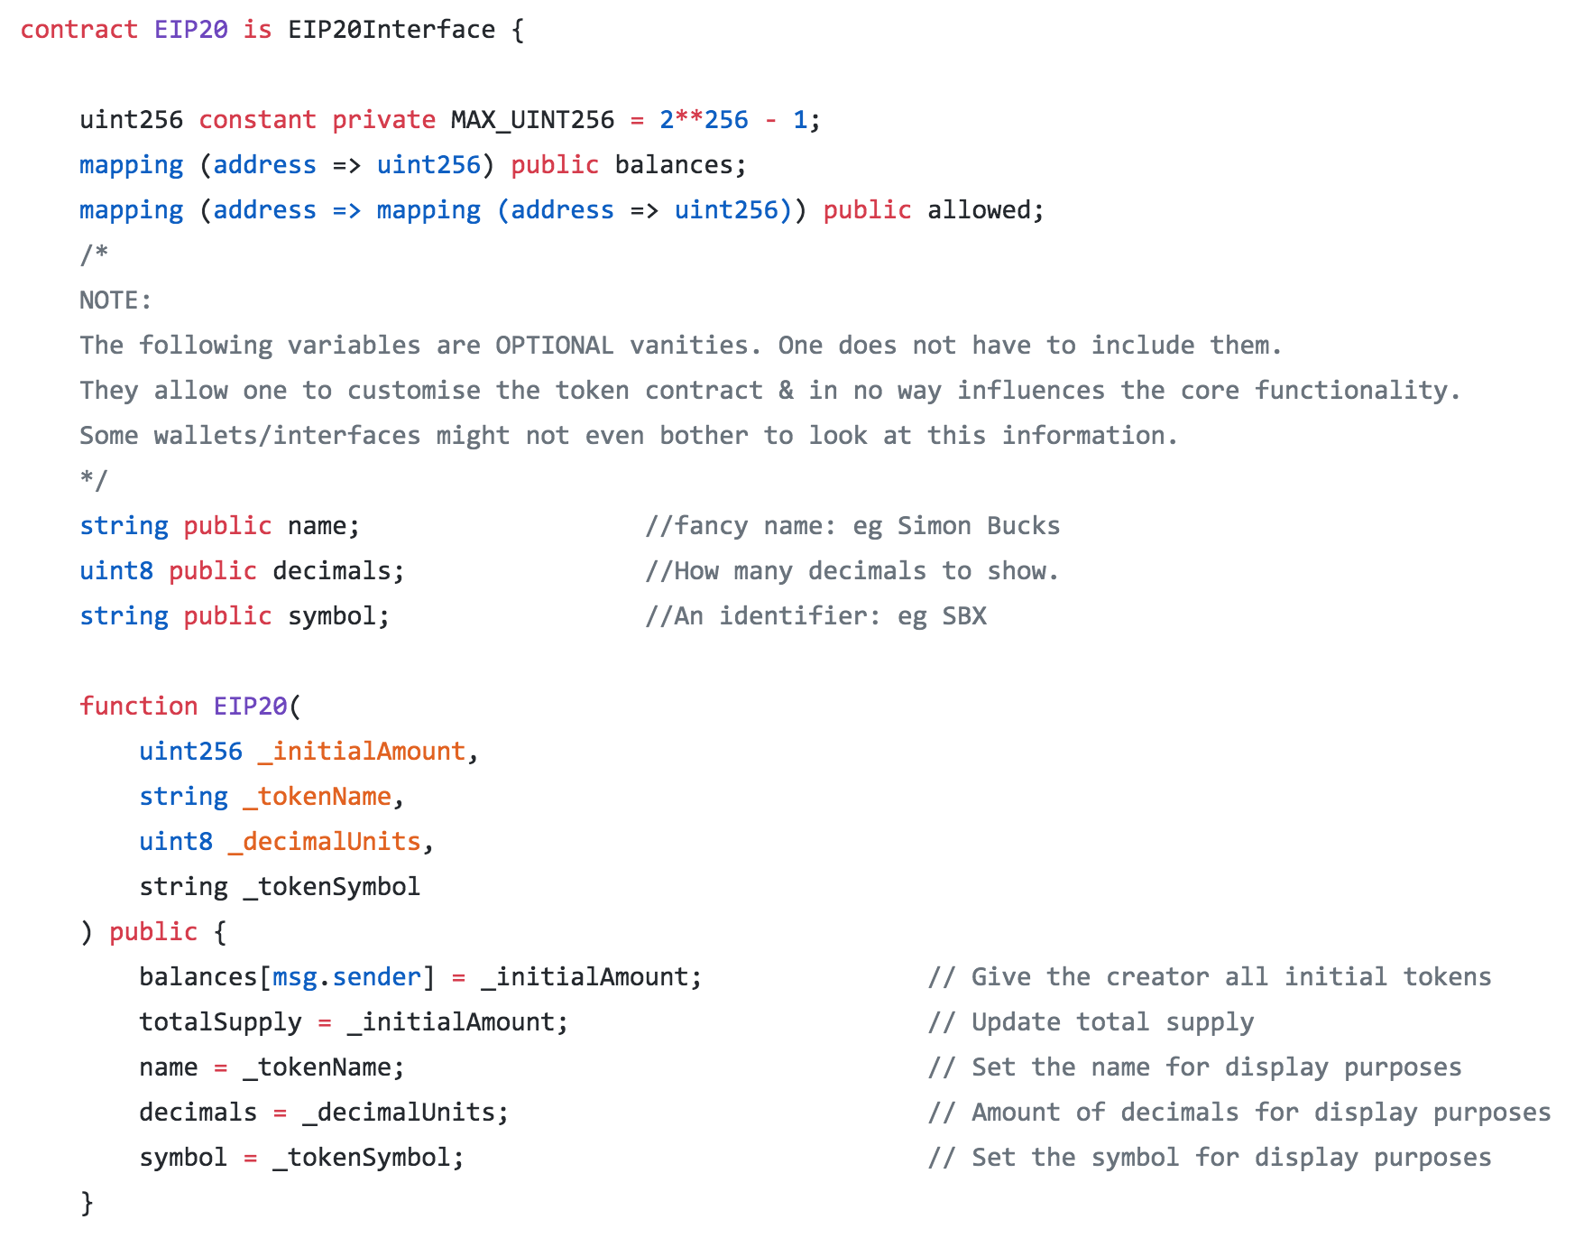
EIP20.sol by Consensys

Slide 103


Slide 104
EVM
Update Ethereum state by computing state transitions
World state
addresses ➔ accounts (balance, nonce, storage, code)

